Slide 1
3d Machining - hsm Rotary & Helmets Phil Dixon – Technical instructor

Slide 2
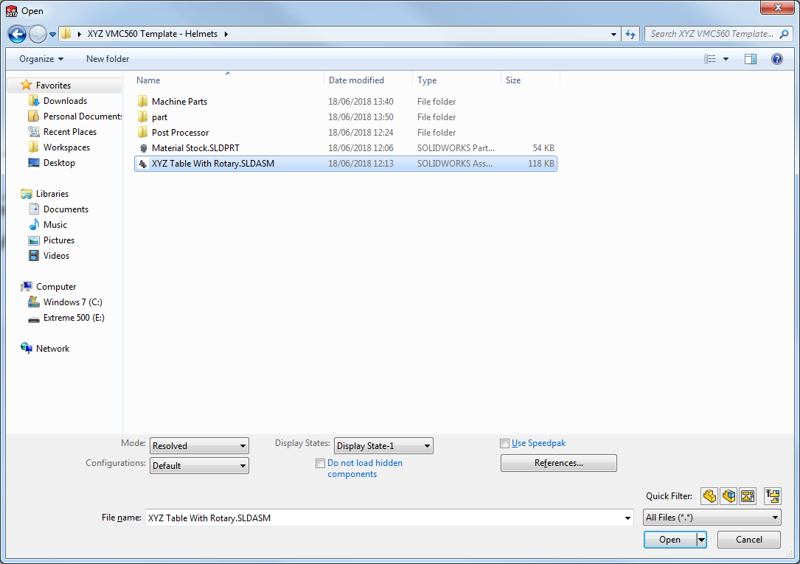
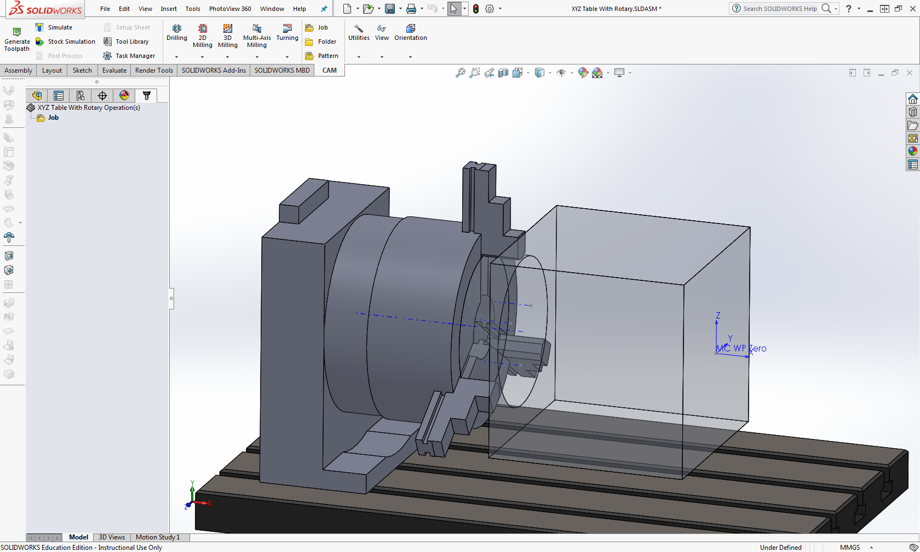
As usual, copy the template from Teachdoc, Select XYZ Table With Rotary.SLDASM.
This is our predefined template.
Note the rotary axis: THIS IS NOT POWERED (NOT CNC CONTROLLED)
We will use this as a fixture to allow multiple machining passes by creating multiple programs at varying degrees to rotation (0, 90, 180, 270 typically). Note the location of the datum. It is usual when using rotary axes to set it on the axis of rotation.
The stock will need pre machining to give a boss that can be held in the chuck. MAX BOSS SIZE IS 150mm it should be 40mm long. MAX MACHINABLE BLANK IS 200x200x200

Slide 3
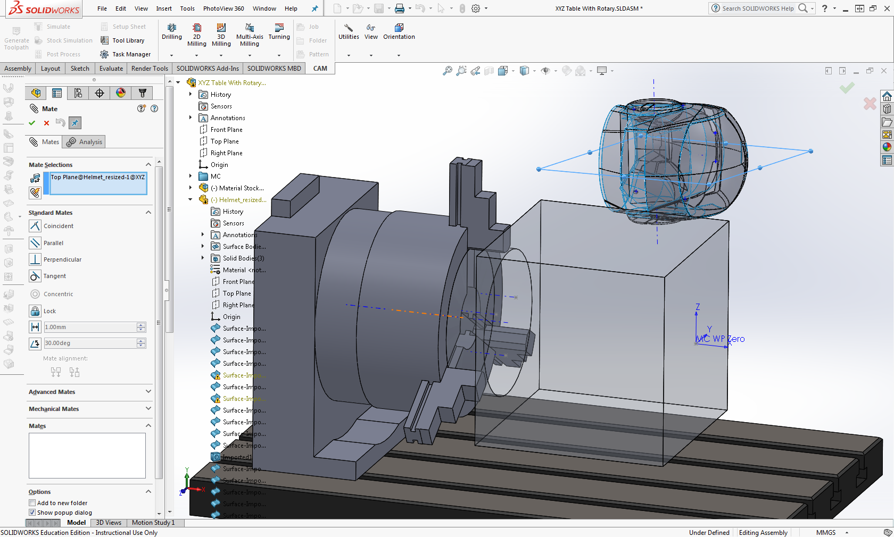
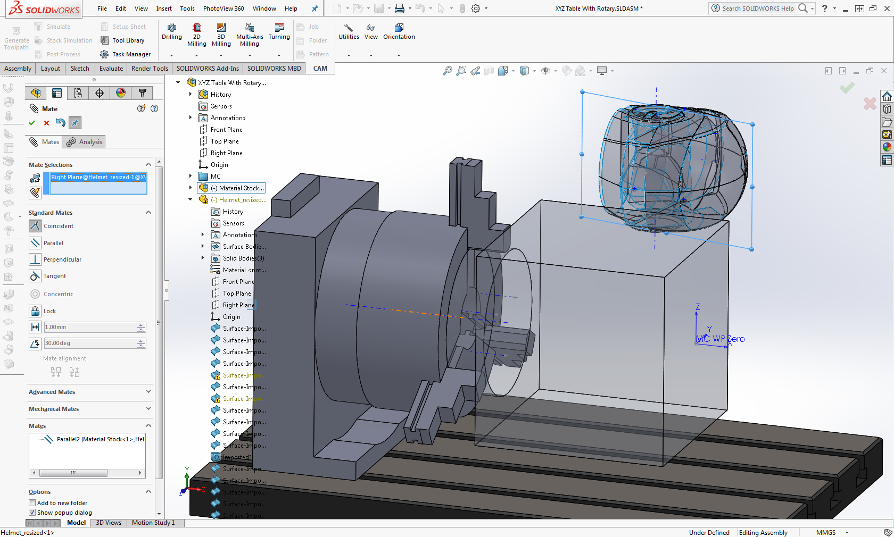
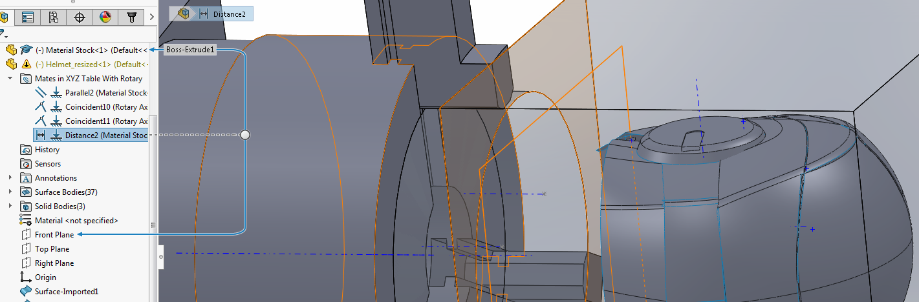
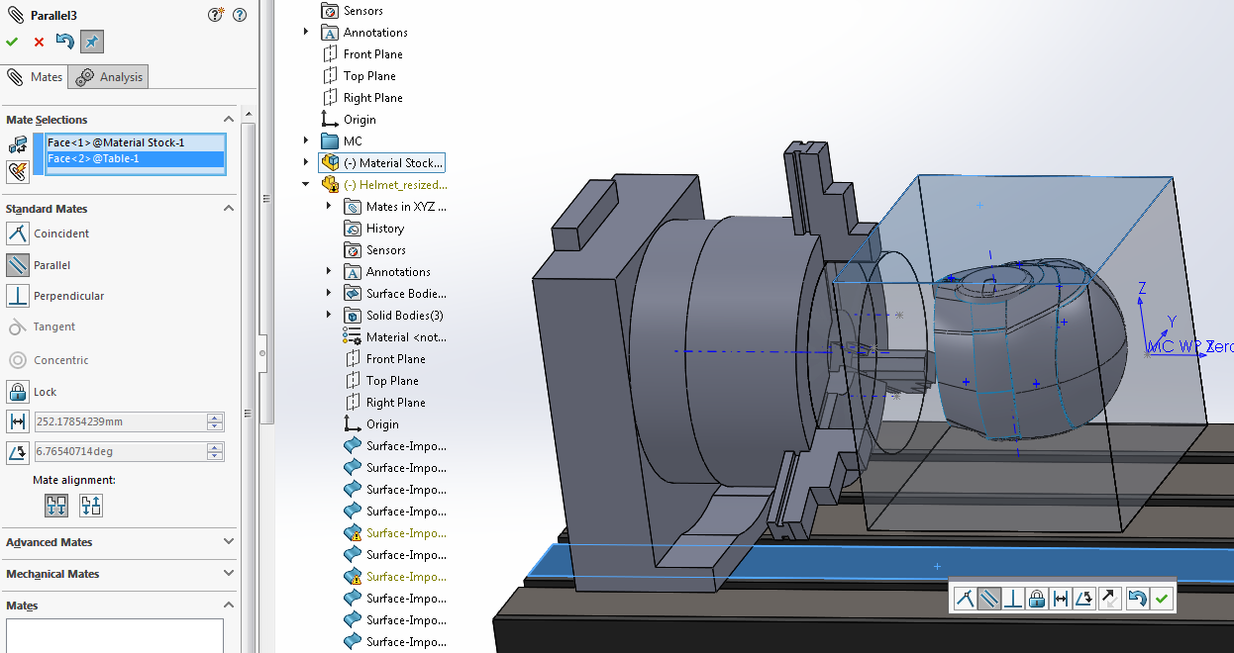
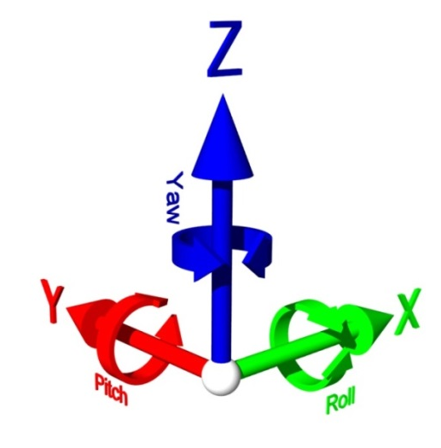
Assembling the part
Care need to be taken to correctly assemble the part. If you are rotating it then the point of rotation (usually the centre line) needs to be located accurately. To this end I am using the split line and setting it coincident with the AXIS OF THE ROTARY FIXTURE. This ensures that it will rotate around the rotation point. Set this parallel to the Y axis too to lock the X rotation to the cube. Repeat with the perpendicular plane, you don’t need to lock it rotationally as the part will be constrained by the last mate – a distance from the remaining plane to the end of the block..
Note, there a 4 mates, 3 axial to position the part and one parallel (in this case) to lock it rotationally.
This has the part located in the machining stock but the block ALSO NEEDS FIXING ROTATIONALLY. It has been left to freely move. Failure to secure the material can result in you scrapping the part!
To fix the block I have used a parallel mate and aligned the material cube parallel to the machine table.
Remember! The six limits of freedom! On a 3D machined part it is VITAL all movement is constrained.

Slide 4
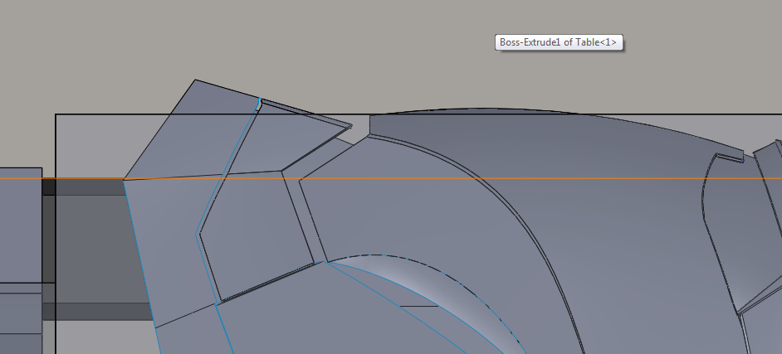
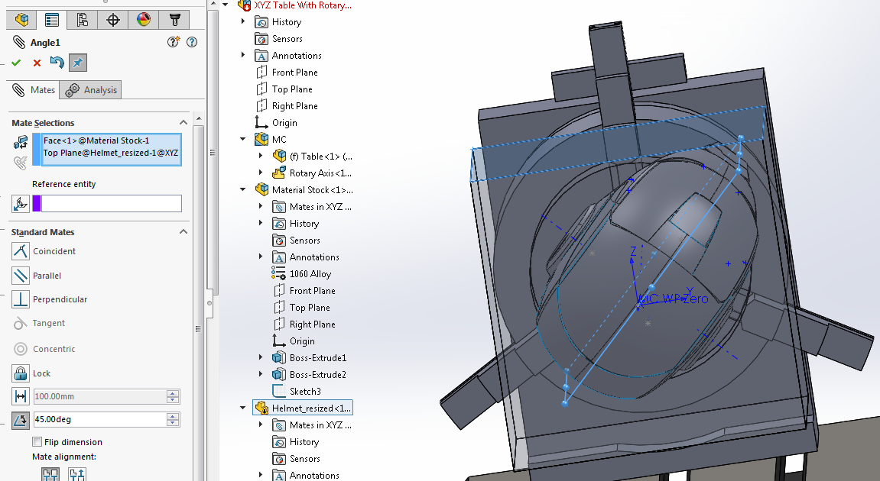
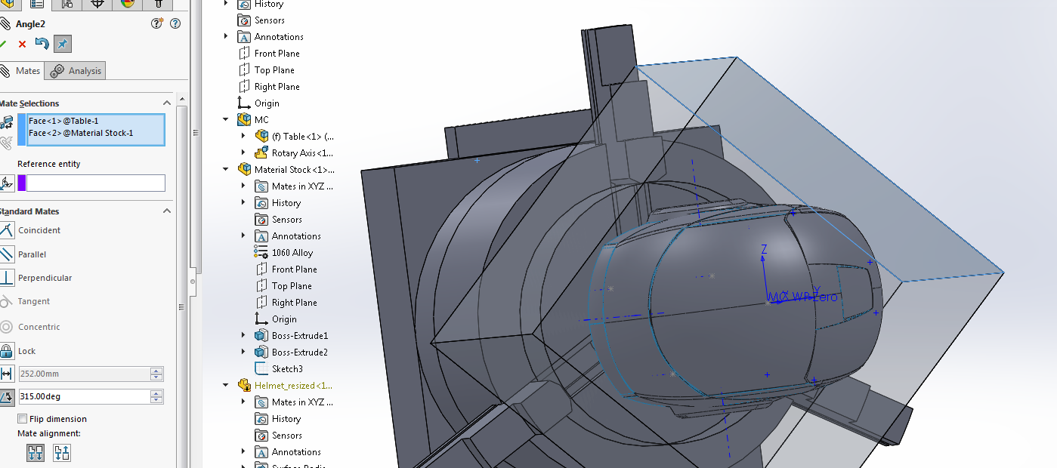
As can be seen from the top view, the model will not fit within the confines of the block. To fix this, rather than setting the model, parallel to the cube, we will change it to an angle mate of 45degrees.
Whilst this fixes the initial problem, it does make it tricky if we were to attempt to machine the model in 2 passes (0 and 180 deg), so we will now alter the cube mate to 315 degrees (360-45) to allow the model to sit flat again. His is why the cube is left to initially rotate.
This puts the part flat. Note there is a lot of material to machine off. We could have sawn this off or started with a round billet. We’ll just machine it off using a face operation.
Note that during all of this the coordinate system did not move. It is not defined using the material stock. Remember this when you come to rotate the part: you need to define a NEW coordinate system rather than rotate the part!

Slide 5
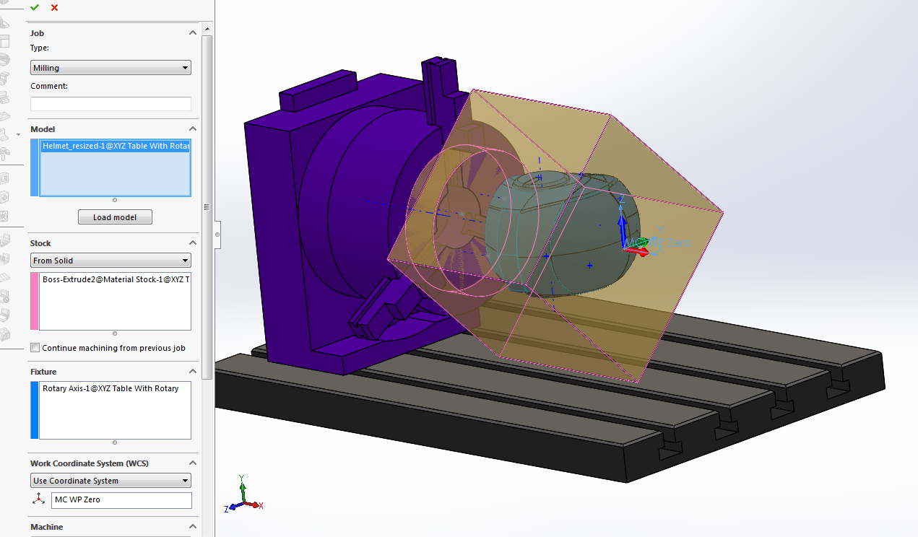
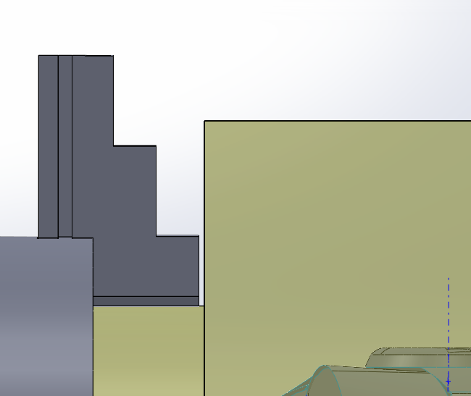
Setting up our first job
From the CAM tab, select JOB, I have already created this first job, so edit the job folder.
Select the model to machine, the stock has already been selected.
IMPORTANT! Select the coordinate system. For the first operation, this will be the predefined coordinate system, for following operations you will need to define and select additional coordinate systems.
As the helmet is symmetrical and not too deep, I am going to rough and finish in 2 halves, 0 and 180 degrees, anything requiring detailing I will rotate and finish off after.
Wherever possible machine as much as you can in each operation rather than keep rotating the part. This is not a controlled axis, movement introduces error!
We are still treating this as a milling job rather than a multi-axis job. If we were using a controlled rotary, then we would select the type mill-turn.
MIND THE GAPS!
Be wary when machining to avoid the fixture both with the cutter and with the tool holder. It is vital that you model the tool holder and correct tool lengths when defining tooling.
The model has been set as a “worst case” with the chuck jaw facing up, It may be possible to rotate the chuck before machining or make the boss smaller.
Be careful with your roughing that it doesn’t go too far over the side and clash with the tool. I have left a 2mm gap. As before this could be changed by lengthening the boss.

Slide 6
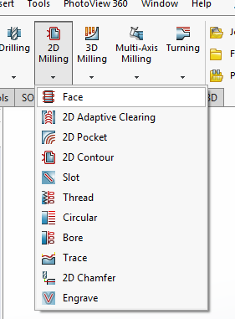
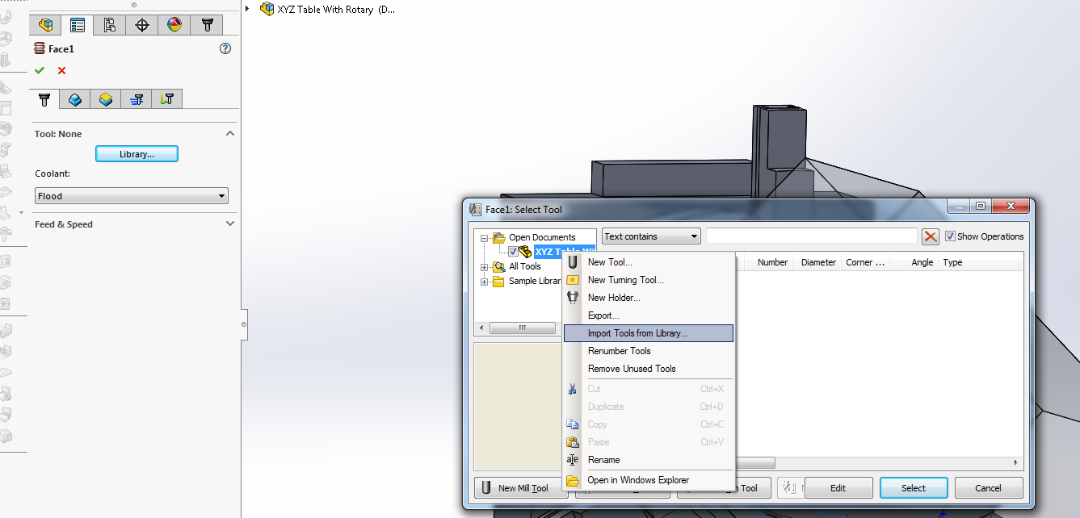
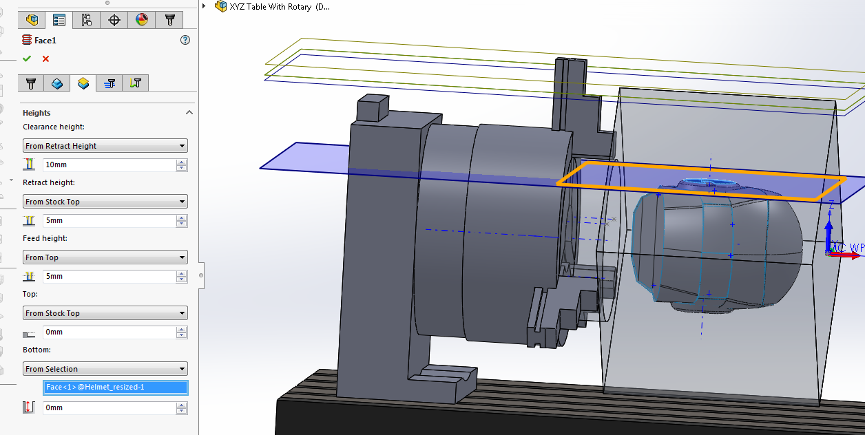
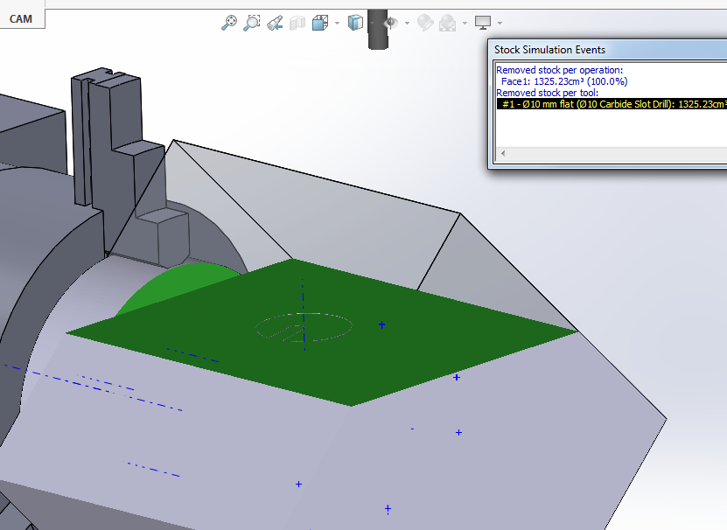
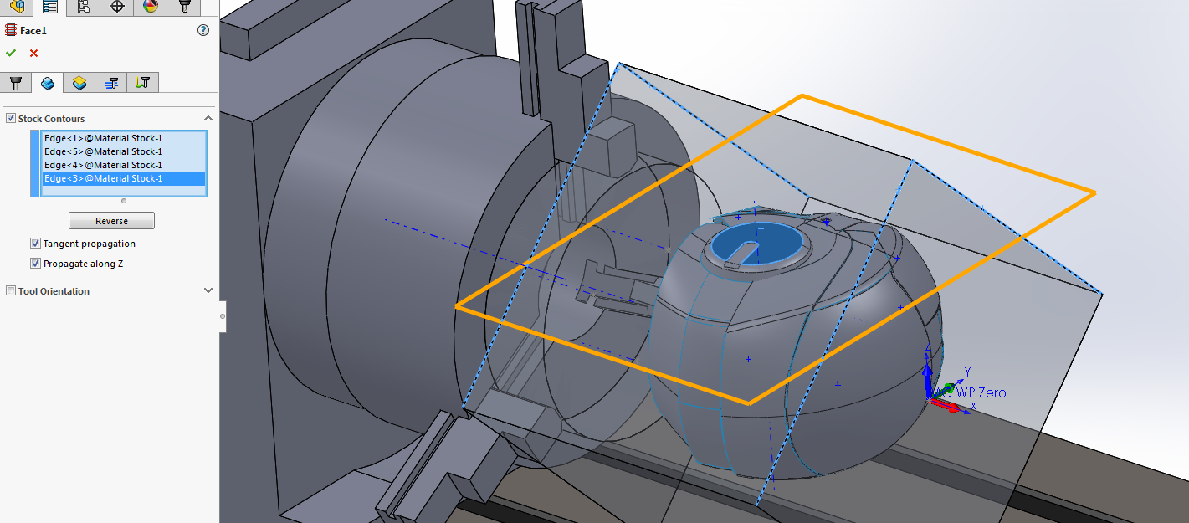
Side one – 0 degrees
Remove the bulk of the stock point by facing to height
Select Face from the 2D menu, import the tools (I’m using the masters tooling) OR define your own.
Whereas in other 2D programs, this pretty much defines the cycle, we need to define the height to machine to, alter the bottom to selection and select the top of our model.
You can see that it is also attempting to machine the entire stock. This won’t work for us as we are holding part of it in the chuck.
Go to the Geometry tab, and check the stock contours box. This allows us to set the area to machine. Pick the 2 outer edges of the cube.
A few other things, I have set to machine in multiple depths of 20mm and left 0.1mm for finishing. I have also changed the angle to 90 degrees. A quick simulation shows we have machined the part and not hit the jaw!

Slide 7
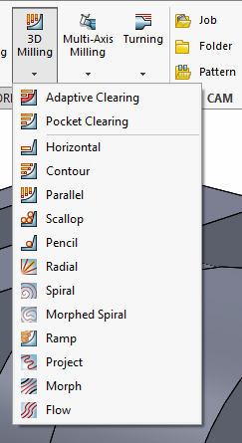
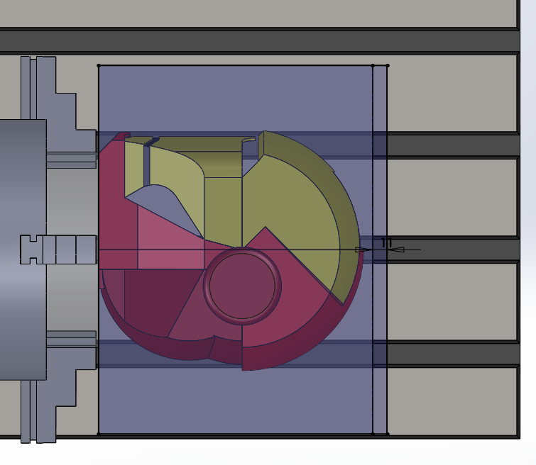
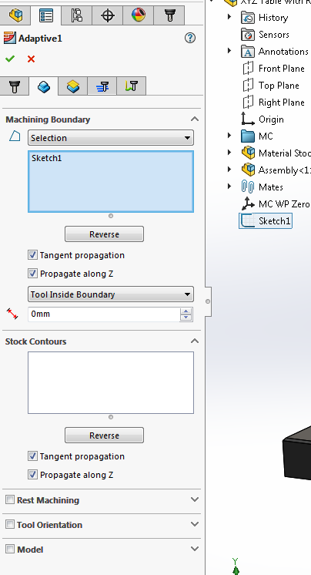
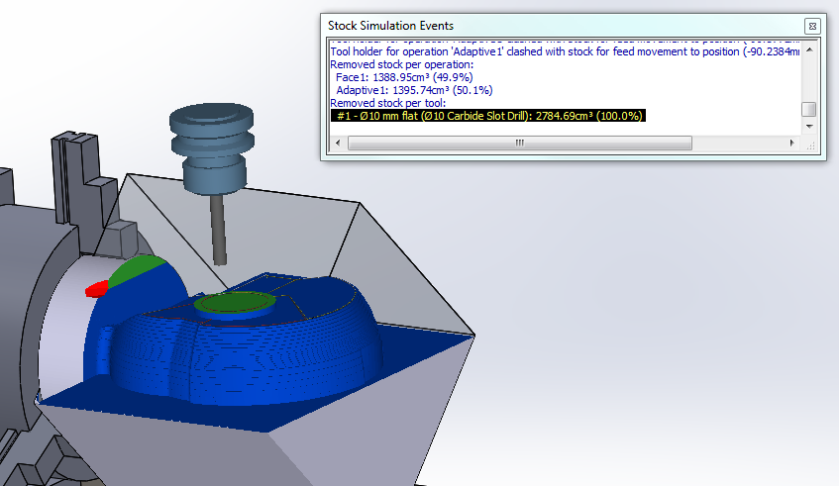
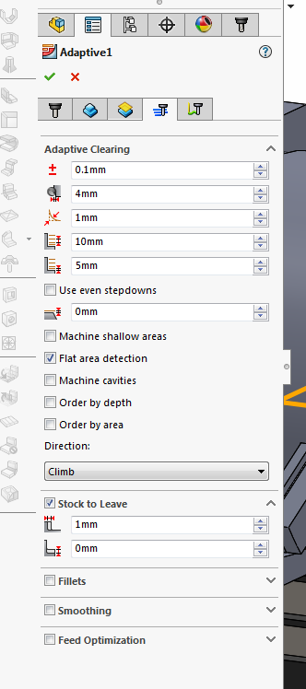
Rough out the profile using 3D adaptive clearing.
In order to miss the fixture we need to set a machining boundary. To do this define a sketch, the right hand side extends beyond the stock to allow it to fully machine.
From the geometry tab, define the boundary by selection and select the sketch previously created. The important thing is to make sure that the tool is set to Inside Boundary.
The simulation shows a clash with the stock, we will need to either use a smaller holder or extend the cutter slightly. In order to save time, I checked the Order By Area option in our setup, this reduces the amount of repositioning moves.
Set the adaptive parameters. As we are machining from ProLab, the cuts are quite low resolution and a large quantity of material has been left for finishing. This reduces dust.
As this model is surfaced and not solid, uncheck Machine Cavities so that it doesn’t try to machine any gaps in the model.

Slide 8
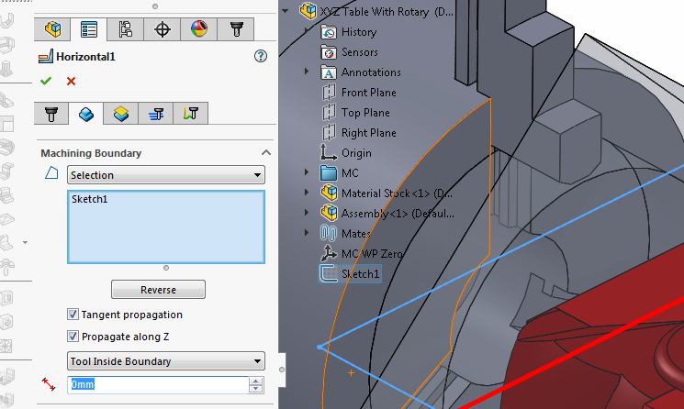
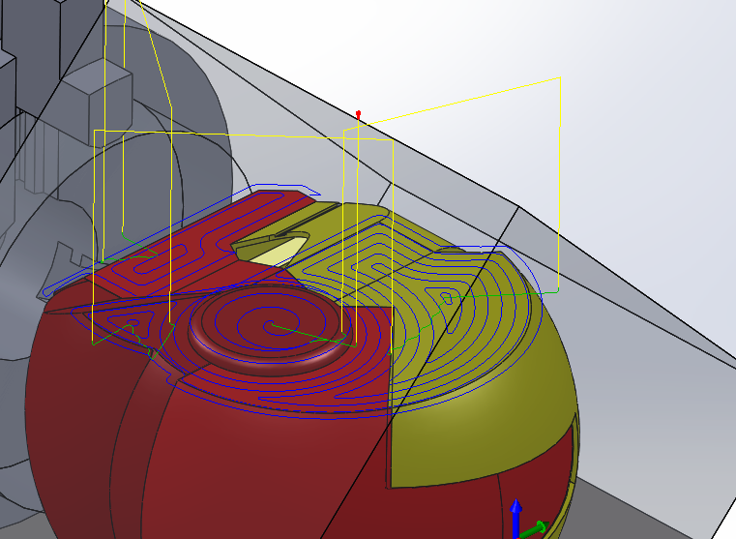
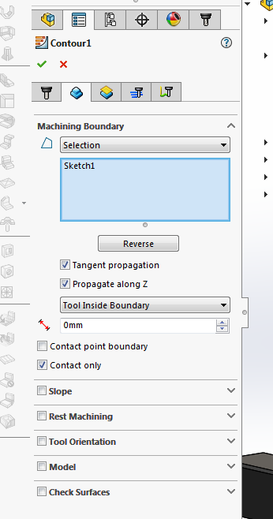
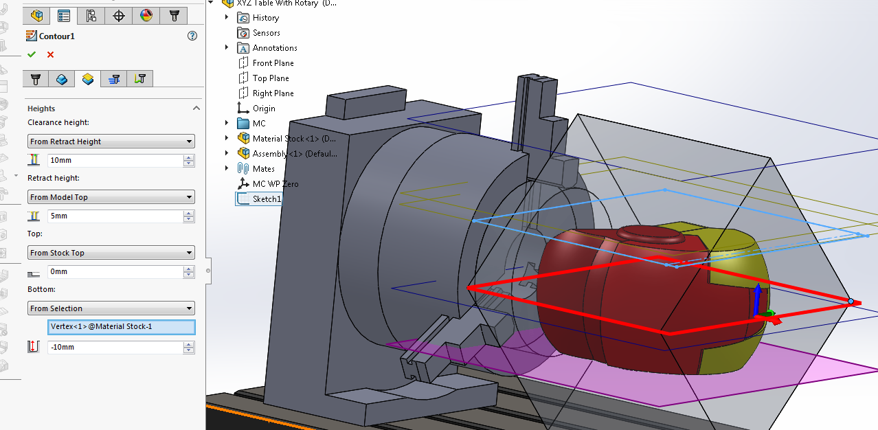
Finishing pass #1, Horizontal strategy.
While we have a cutter loaded with a flat bottom, it makes sense to finish all of the flat areas. HSM does not regard these as a 3D surface and so they wouldn’t be finished using the contour strategy we will use later. We could use the parallel to do the entire helmet but it doesn’t give a great finish.
As we wish to machine all the flat areas, we’ll let HSM work out which these are by defining the boundary. Select the previous boundary (which was the sketch we created). Make sure the tool is inside the boundary otherwise we’ll clash with the fixture.
As before we’ll use a boundary to define our machining (you guessed right, use the sketch!)
Important to note that we cannot use Contact Point Boundary as it would roll over the edge and hit the fixture. Make sure it’s unchecked.
Also, the height will need setting otherwise HSM will attempt to machine to the bottom of the part. I have set it 10mm past the centre line to allow for the radius of the cutter.
You can change the surface finish by setting the cusp height in the passes tab.

Slide 9
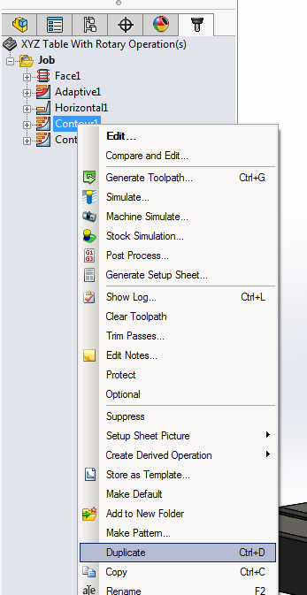
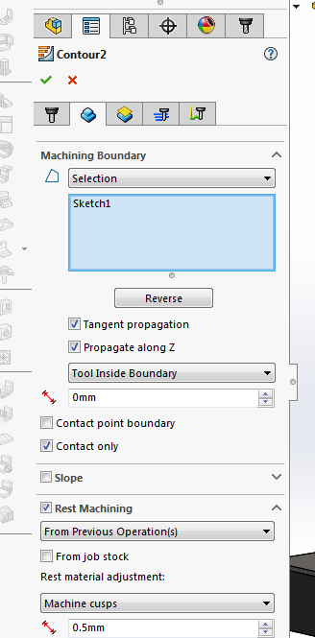
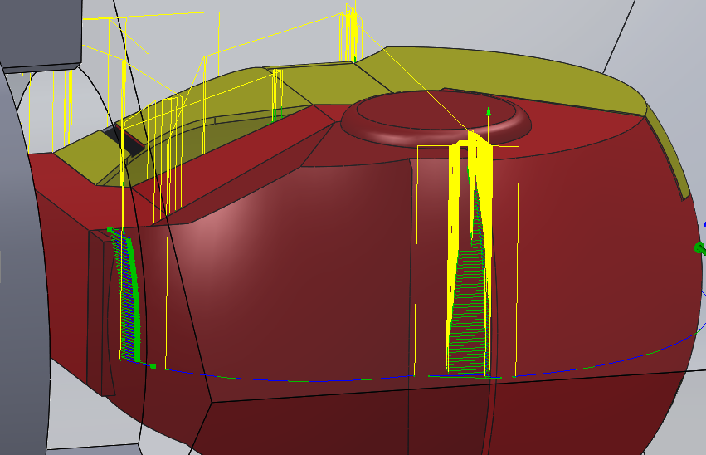
Finishing pass #2, Horizontal strategy with rest milling.
Now we have our part machined, we are going to refine some areas by using a smaller cutter. Rather than remachine the whole again we will use the rest milling option to just remove material where we can.
As we have a successful sequence above, we will duplicate that and just change the tool and parameters. Right click on the contour sequence and select duplicate. This will create a copy of the sequence.
Edit the new contour and change the tool to the 6mm ball nose.
In the geometry tab, check the Rest Machining box and set to previous operation.
In this case, this probably is not required as we will remachine some areas in later job rotations. We’ll supress this for now rather than delete it.

Slide 10
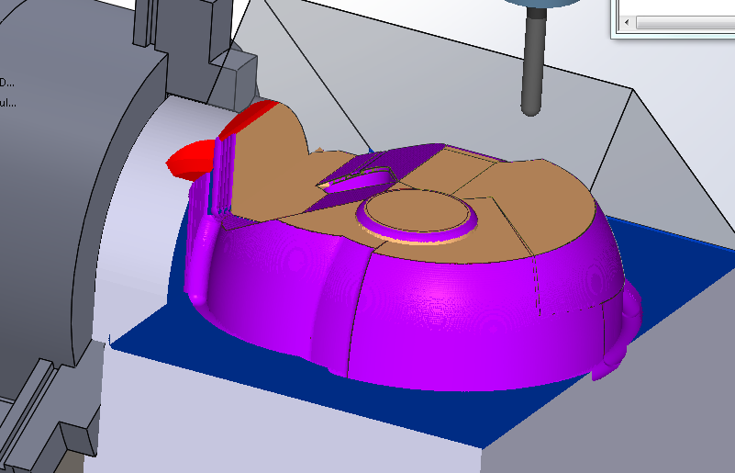
So far, so good! We have half the helmet machined and it’s taken just over an hour to machine. There’s still a clash to contend with, but we’ll ignore that for the purposes of this tutorial.
Next we are going to manually rotate the part 180 degrees and then run our second job. If we had a CNC controlled rotary axis, the machine would do this and we would output all of the jobs in a single file.
As it is, we’ll create each job separately and load each as we go. In other words we’ll treat it as 2 jobs rather than one.

Slide 11
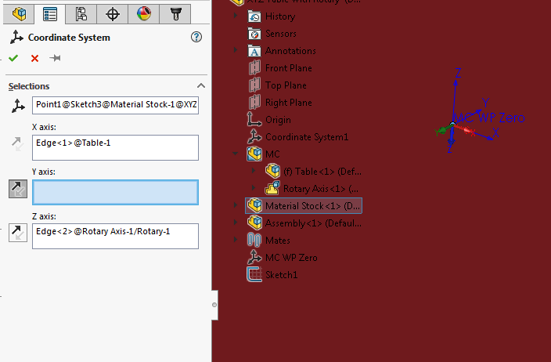
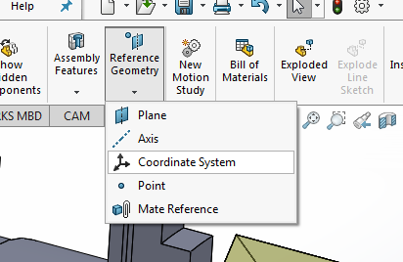
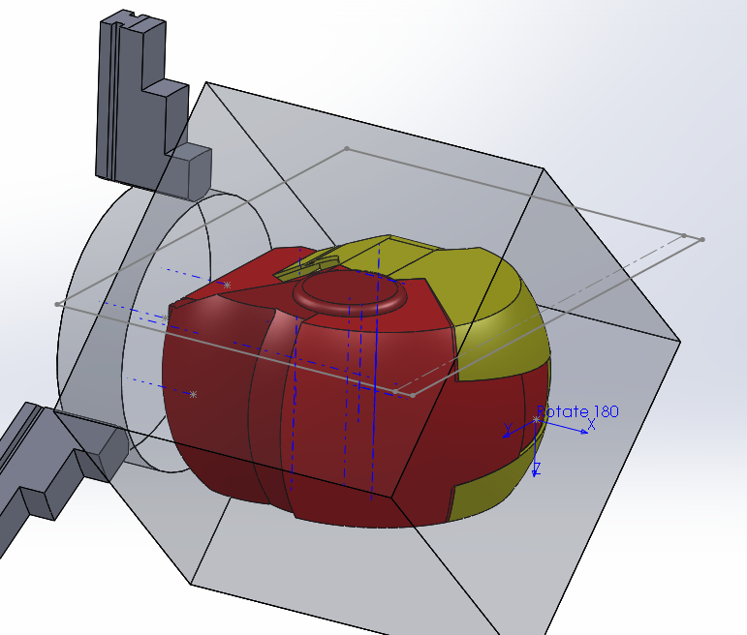
Setting up our Second job – 180 Degrees
Up to now, everything we have done is pretty much the same as any other 3D machined part. From here it gets a little more tricky! Remember, we don’t rotate the part, we program from another plane.
To do this, first we need to define a new coordinate system. This will have the Z pointing down rather than up and the Y mirrored to how it is now. I have created a point on the stock for the origin.
Select the point as the origin point. I’d suggest selecting the table edge as the X and the downright of the fixture as Z. Flip Y until you get the orientations correct:
Z pointing down
Y pointing towards the front
X as before, pointing left to right
I have renamed this to Rotate 180. This will then appear on our setting sheet which is helpful.
From here, it’s probably best to start hiding some of the assembly. It can get confusing as you start to machine. I have hidden the table, the rotary fixture and the coordinate system. I have left the jaws as I need to ensure the cutter doesn’t clash.

Slide 12
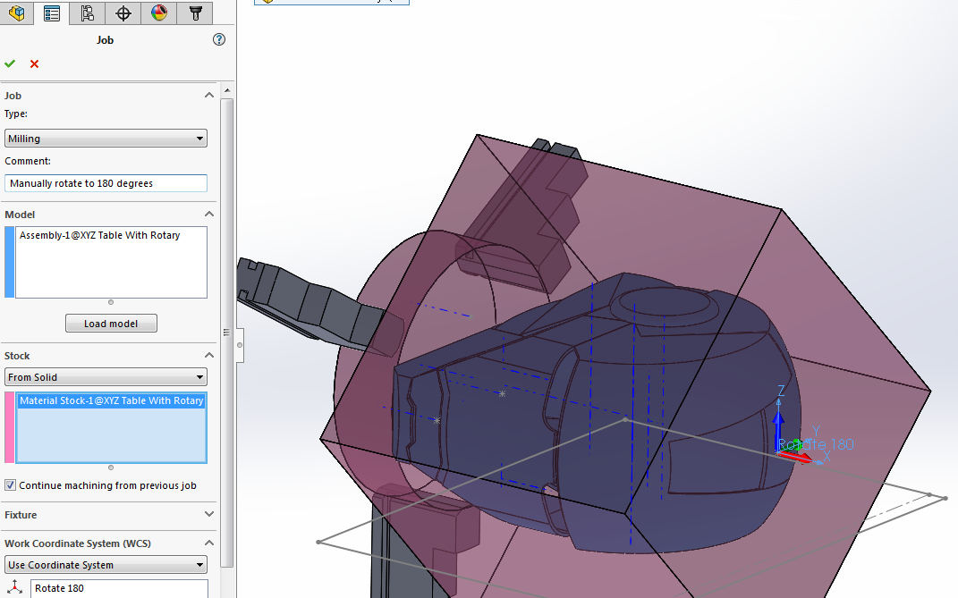
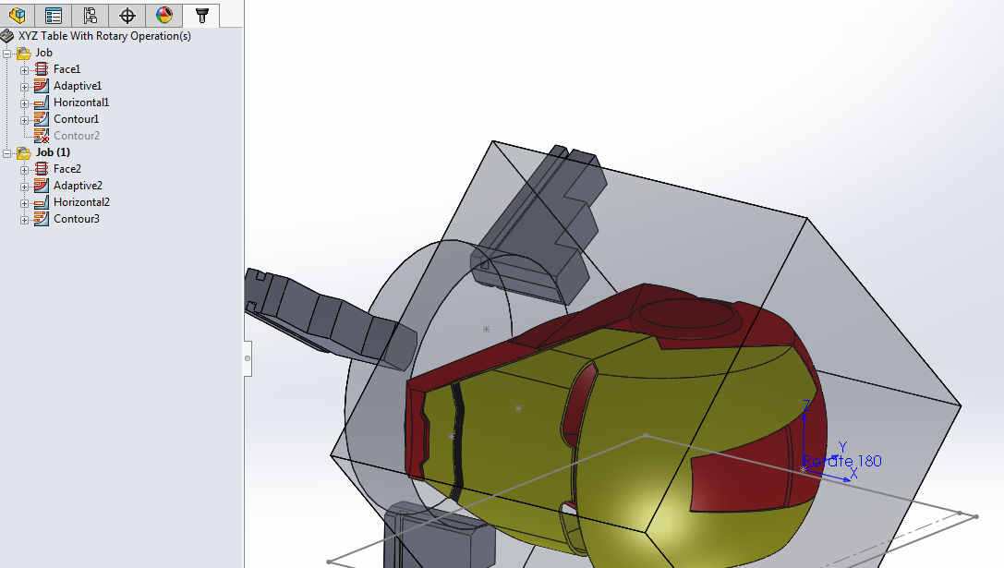
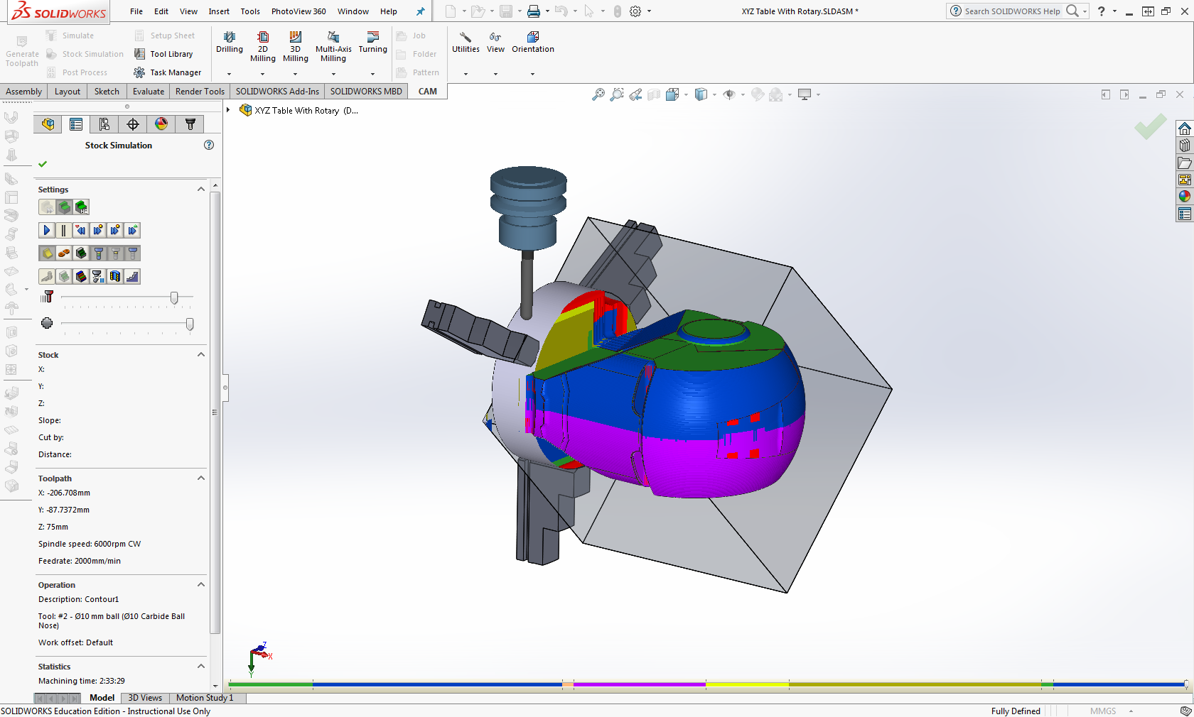
In the same file, create a new job. Definition is pretty much as before, The same model and stock should be selected. The main difference is the selection of the new Coordinate system as our datum.
In the view shown I have manually rotated the view NOT the model!
I have also checked the Continue Machining From Previous Job. This will look at material removed already and not attempt to remachine those areas.
As our sequences are the same, copy those from the previous job and paste them into the new job, You may need to change a few heights (such as the face selection for the facing op) but it should be pretty much good to go. Hit generate toolpath.
Second side should not take more than 5 minutes to program as we took care with the first side to get everything correct.
A simulation of both jobs shows us a fully machined helmet. Looking good!
We could further refine the face detail by defining a new coordinate system and rotating it 90 degrees, I’m sure by now you can see how that is achieved.
Output each job as usual, create a setting sheet and machine your part!

