Slide 1
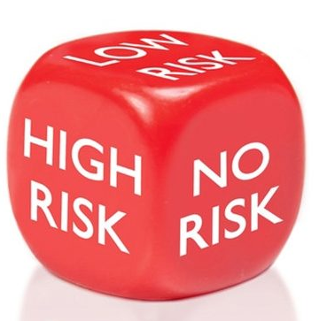
CBE Risk Assessment Induction Training
This Photo by Unknown Author is licensed under CC BY

Slide 2
Introduction
What are Risk Assessments? What are Hazards and how can you control Risks?
Importance of Risk Assessments
Types of Risk Assessment
Writing Risk Assessments
Existing Risk Assessment review process
Approval of Risk Assessments Process
Where can I find Risk Assessments?
More information on Risk Assessments

Slide 3
What are Risk Assessments?
A risk assessment is simply a careful examination of what, in your work, could cause harm to people, so that you can weigh up whether you have taken enough precautions or, whether you should do more to prevent harm. Workers and others have a right to be protected from harm caused by a failure to take reasonable control measures ( Health and Safety Office)

Slide 4
Risk Assessments
When thinking about a risk assessment, remember:
• a hazard is anything that may cause harm, e.g. chemicals, electricity, working at height, trip hazards etc
• the risk is the likelihood that somebody is harmed by the hazard. This together with an indication of the severity of the resulting harm can be used to quantify the risk.
• harm is the injury, ill-health to people, costs and effects on the University
( Health and Safety Office)

Slide 5
Controlling Risk
1. Elimination: Can I get rid of, (avoid), the hazard altogether? If not, how can I control the risks so that harm is unlikely and the risks reduced to an acceptable level? When controlling risks, apply the principles below, if possible in the following order:
2. Substitution: Try a less risky option (e.g. use a machine that vibrates less than the former or a chemical that is less hazardous but does the same job);
3. Engineering controls: Prevent access to the hazard (e.g. by guarding or enclosure);
4. Administrative controls: Organise work to reduce exposure to the hazard, e.g. put barriers between pedestrian’s and vehicles, and / or, provide welfare facilities (e.g. washing facilities for removal of contamination, limit peoples exposure).
5. Personal Protective Equipment (PPE) and other safety equipment: Issue protective clothing, footwear, goggles, ear defenders, and / or, equipment such as fall arrest equipment, lifting equipment etc. Make sure it’s the right equipment for the job, it’s used correctly and people are trained to use it.
PPE is the last resort – can be very effective, but must be used in combination with other controls!
(Health and Safety Office)

Slide 6
Why are Risk Assessments Important?
Risk Assessments should not be seen as ‘another form to fill in’ or a ‘tick’ box exercise.
Risk Assessments provide an opportunity to assess and reflect about what you plan to do, identify health and safety hazards and evaluate the suitability and effectiveness of existing control measures.
For your own safety and those around you.
Legal requirement
Protection of Staff/Students in the workplace.
Prevention is better than cure…

Slide 7
Types of CBE Risk Assessment
1)Biological Risk Assessment
Form Link - https://www.lboro.ac.uk/services/health-safety/documents/#tab4
New Biological Material- Assessing the material and what you intend to do with it.
Is material HTA Relevant?
What Hazard Group is it?
2)GMO Risk Assessment
GMO material
Complete Biological Risk Assessment and additional GMO Risk Assessment.

Slide 8
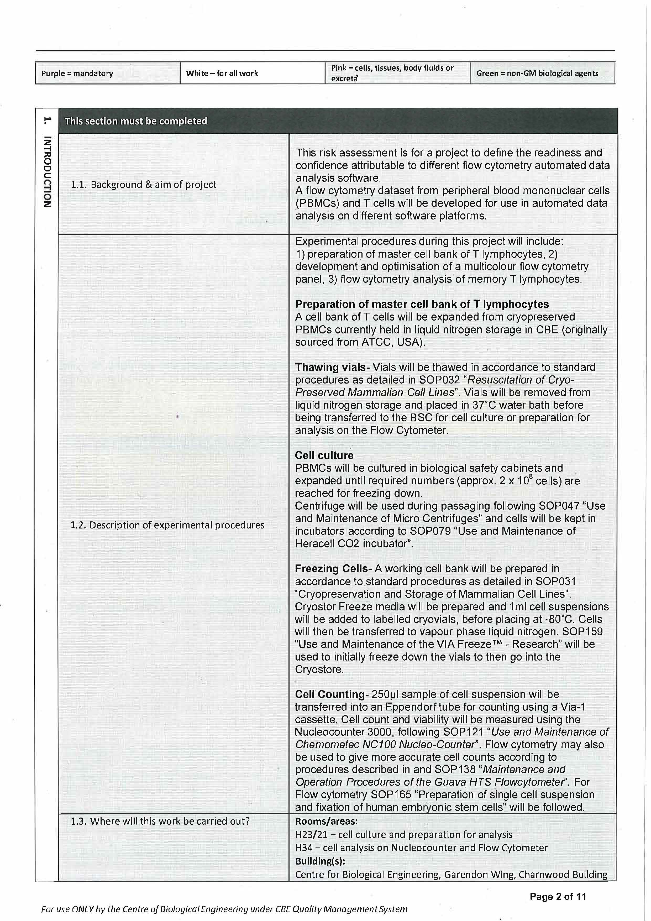
Biological Risk Assessment ( Please read notes)
Notes:
Page 1 – on this page you need to complete the title of the project and who is part of this project including the PI. Remember to add your name, date and signature.
Page 2 – Introduction – This is a description of the project, experiments that will be conducted and where it will take place. Give as much detail as possible e.g assays you will use, equipment you will use.

Slide 9
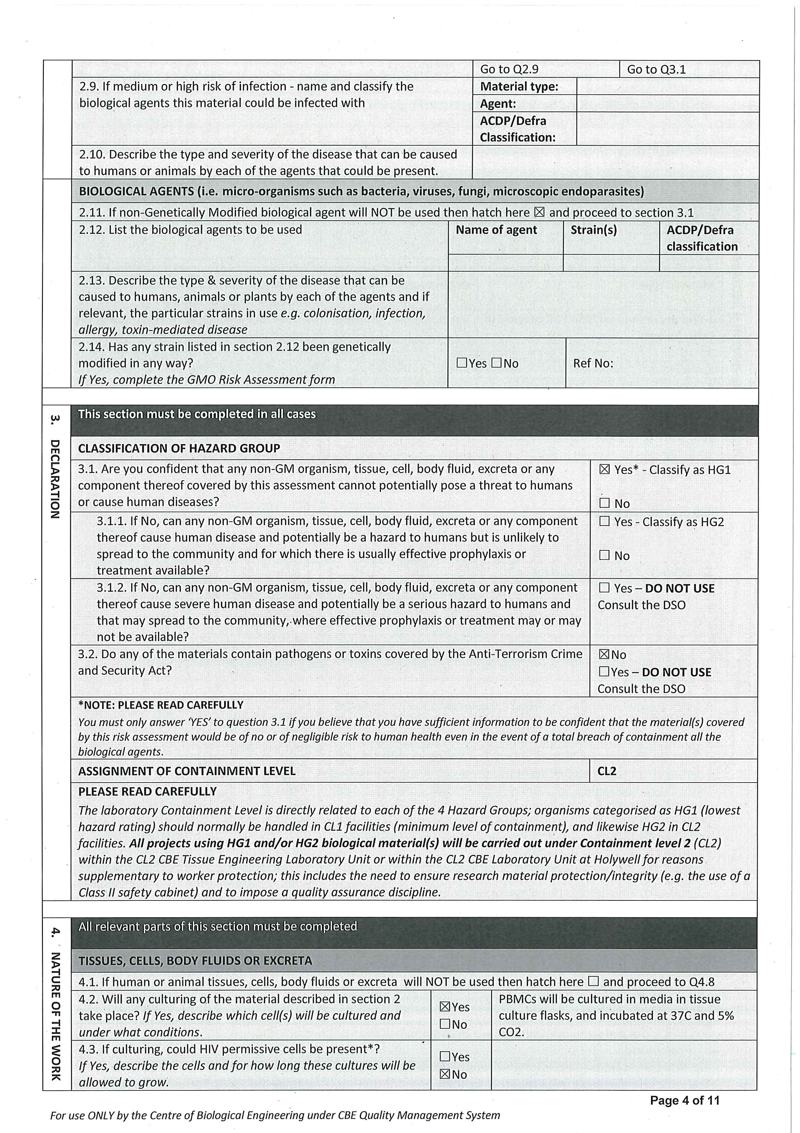
Notes:
Page 3/4 – These pages are about the biological material you intend to use. What is it and where is it being sourced from? What has it been screened for? Answer the questions about material before selecting the classification. If you are unsure how to classify your material please seek advise from your supervisor. If you tick the HTA box another set of questions will drop down on how you will use and store the material.
Tissues- This section wants to know more about how you will culture the material.

Slide 10
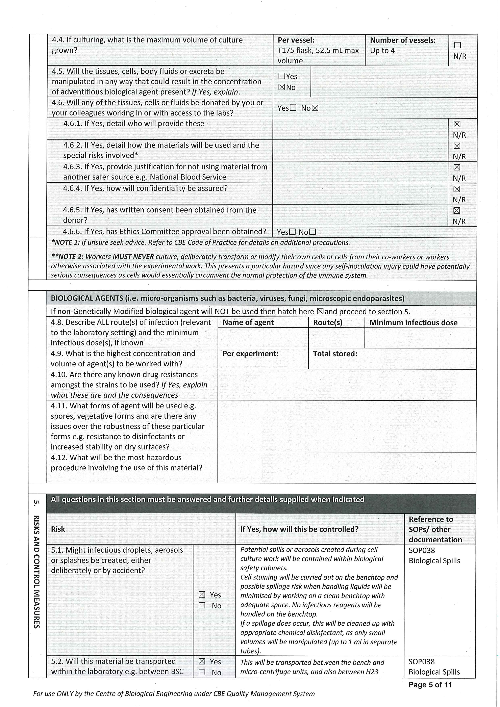
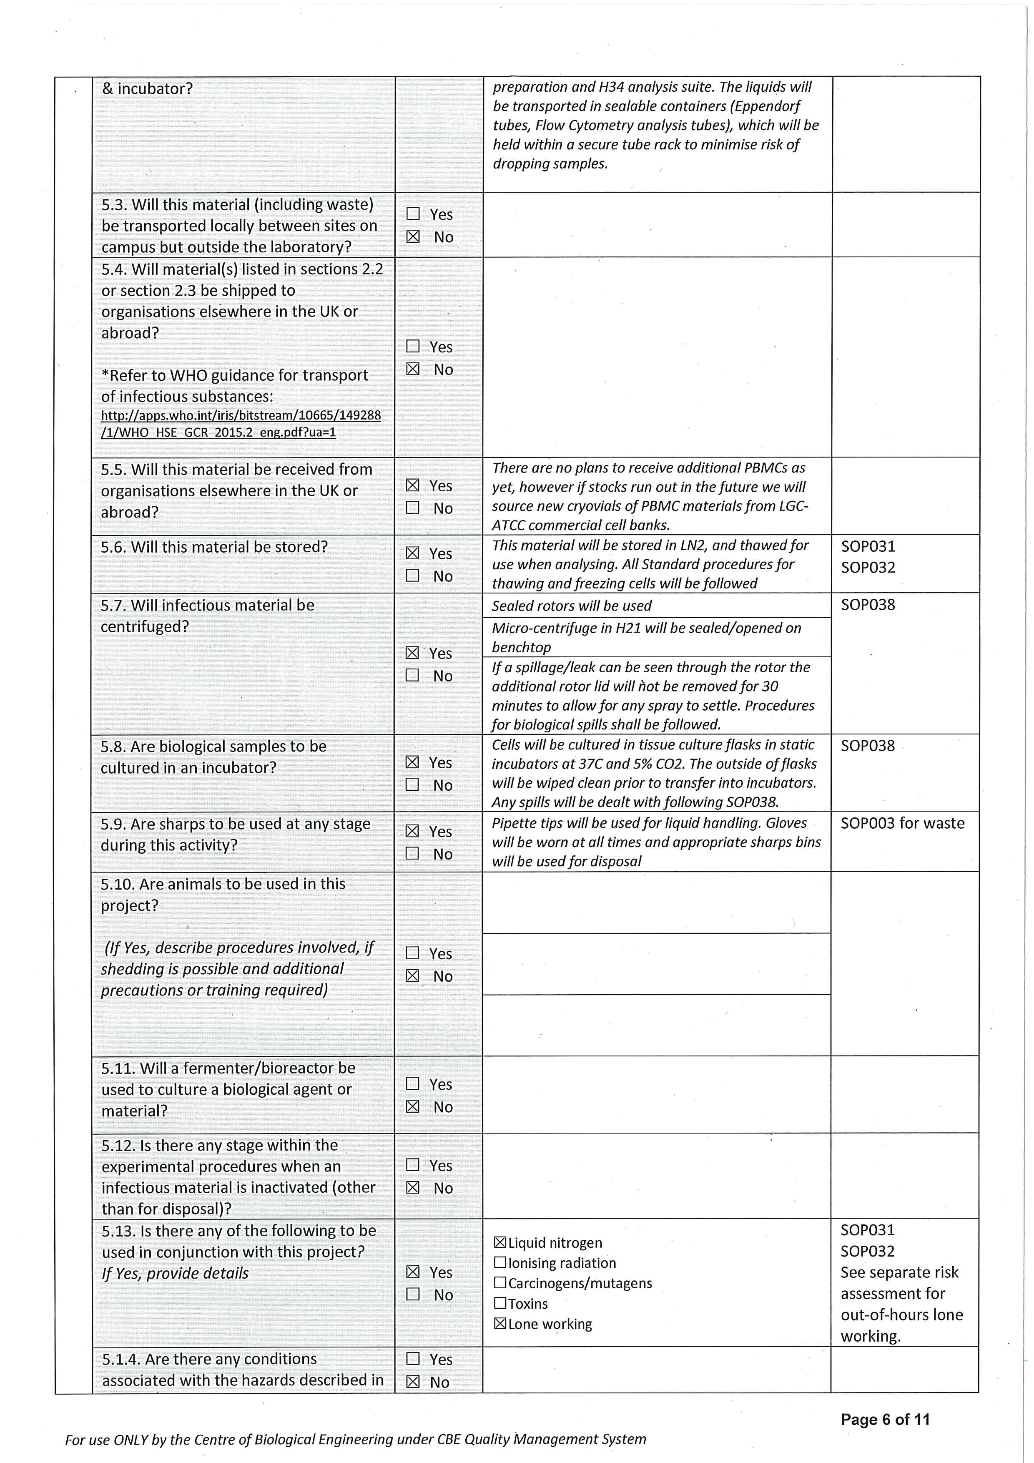
Notes:
Page 5/6 – Risk – This section will ask a series of questions about how you intend to mitigate any risks with the procedure. Any answer you say ‘yes’ to ensure you have completed the section about how you will mitigate the risk and reference the relevant SOP where applicable. Add as much detail as possible
E.g if you answer yes to sharps – detail what you will be using and how you will dispose of them safely.

Slide 11
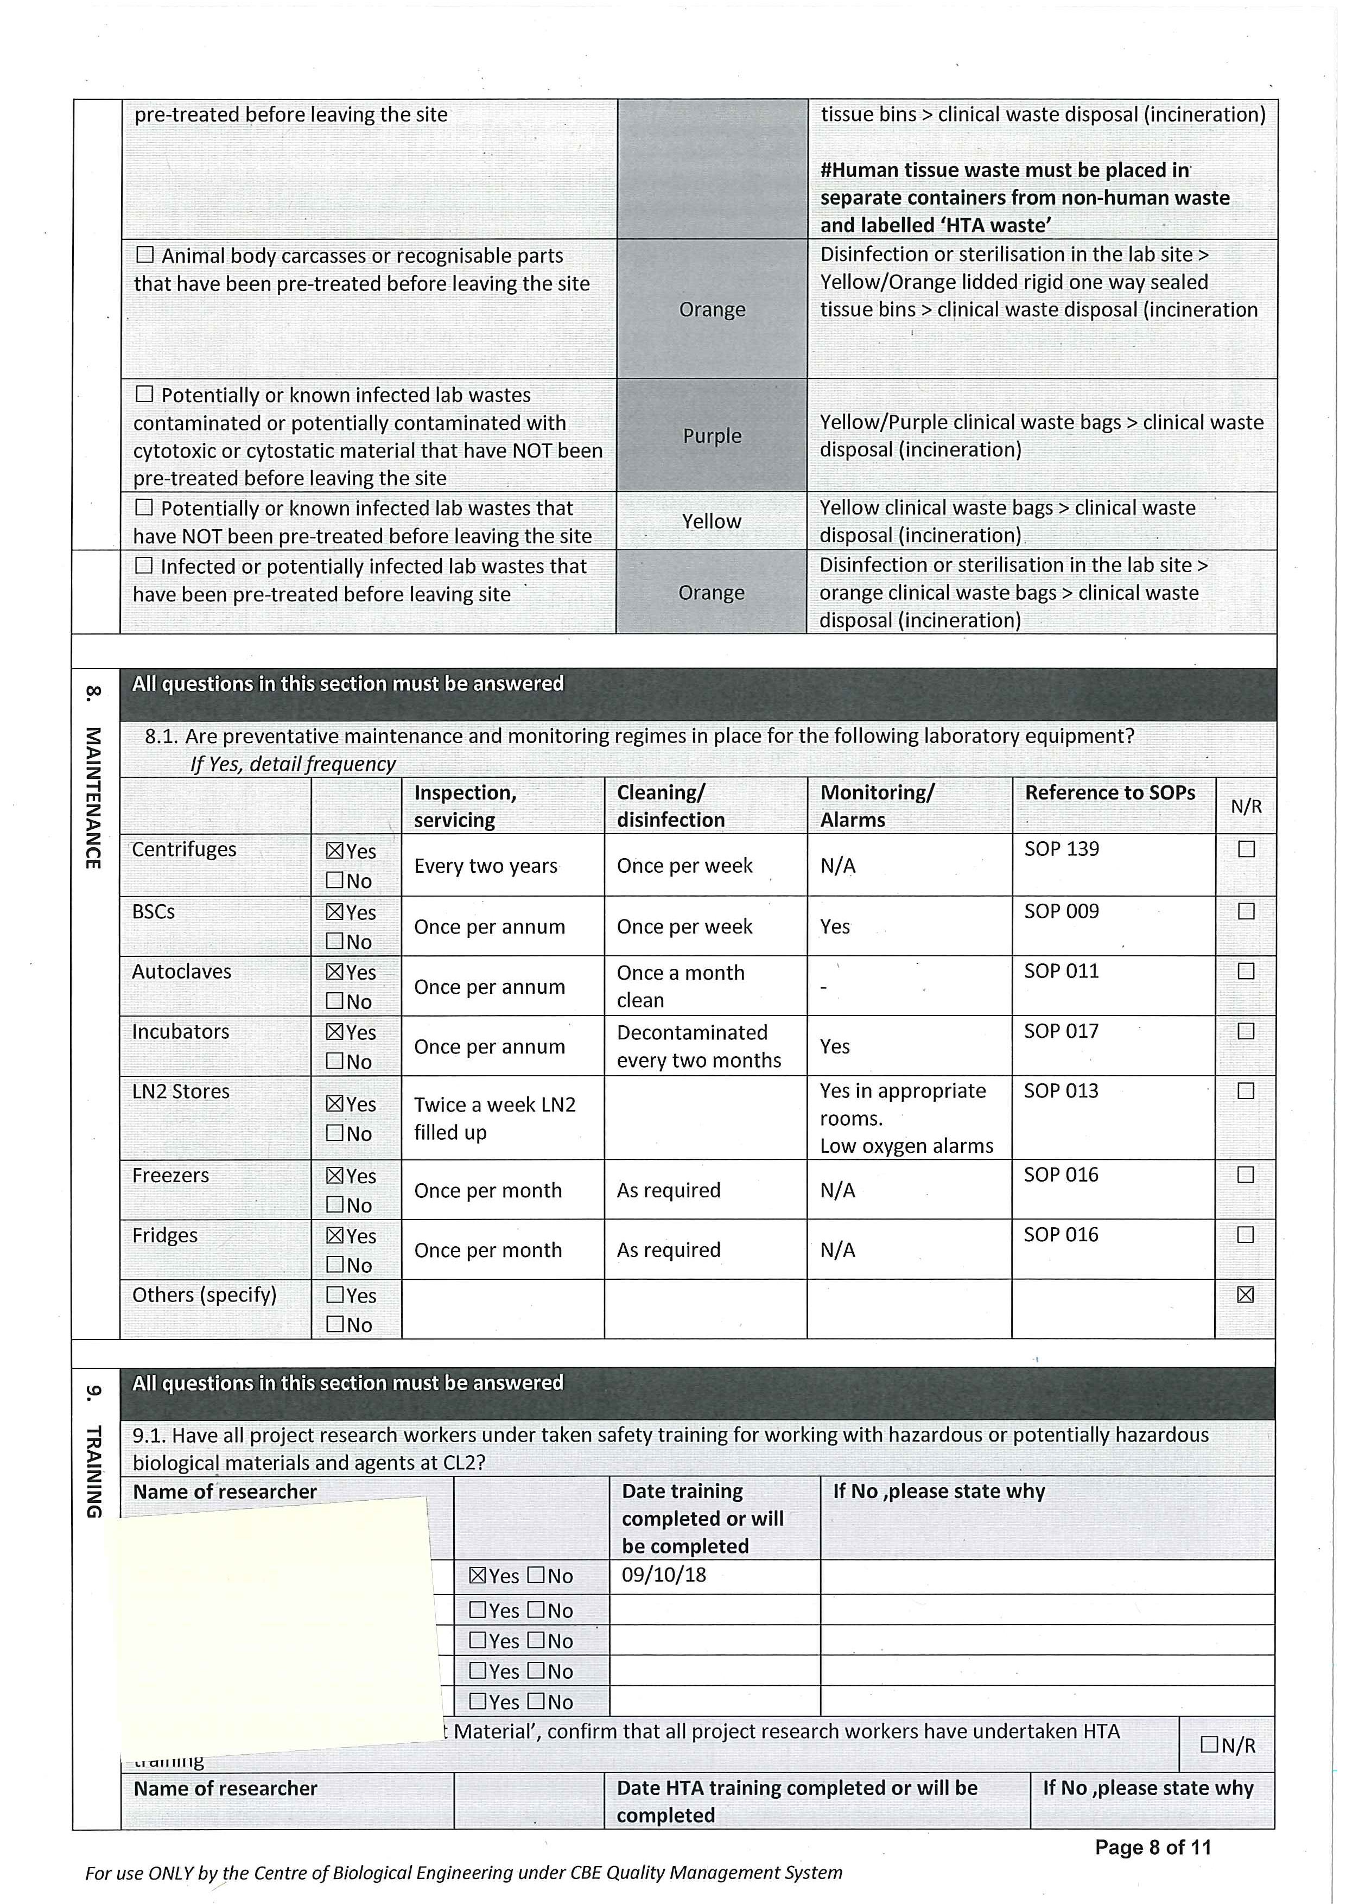
Notes:
Page 7 - PPE – This section looks at the PPE required. Answer the questions in as much detail as possible. Include information about eye wash stations, hand washing facilities . Lab coats are cleaned every month.
Waste – Think about the types of waste you will produce and how you will dispose of it. Provide details of the waste procedures. Describe the autoclave cycles. Do we have all the routes in place for what you will be disposing of?
Page 8 - Maintenance – Think about all the equipment you will use. How do we maintain it?. Any you tick you must provide information. e.g incubators – how do we clean them/. Do they alarm? What does that mean?
Training – complete the section of training for all those involved or named on the project.

Slide 12
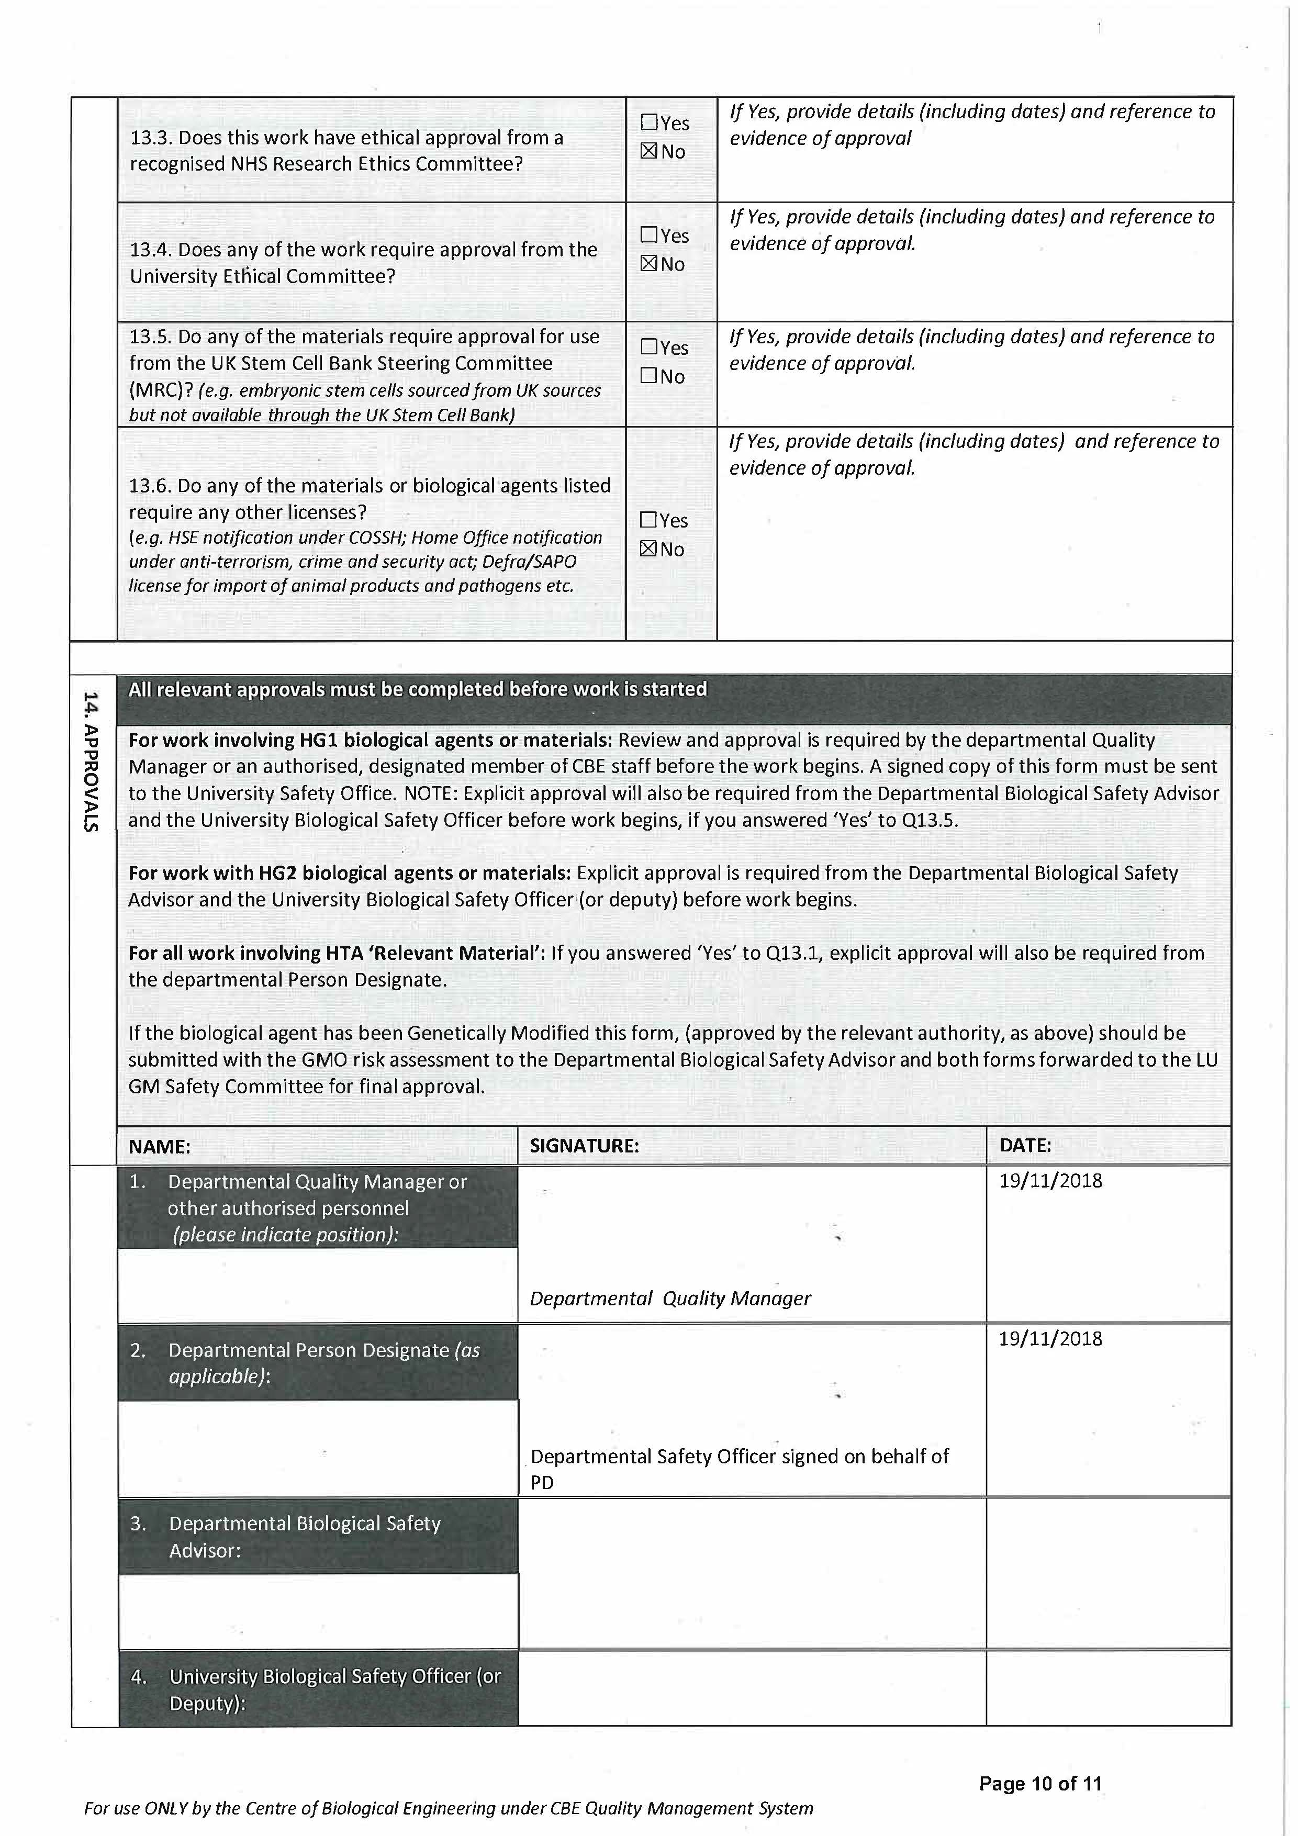
Notes:
Page 9 – Emergency Procedures – Think about what the emergency procedures/Spill response and for each piece of equipment you intend to use. Think about accident procedures. What do we do if we splash something in our eye?
Access – Any questions you answer yes – give detail. How do we separate out project work ? How do we keep the facility secure?
Occupational Health – Think about your own situation and health. Do you need additional vaccinations?
Page 10– Notifications – go through each one and decide if it is relevant for your work
Signatures – Supervisors/PI’s MUST review your BRA first.
HG1 BRA – can be signed off by a suitably experienced CBE member following review by the supervisor.
HG2 – These must be send to Julie Turner

Slide 13
Types of Risk Assessment
3)Safety Risk Assessment
( Process, Method Statement and COSHH)
On this form you complete/tick the relevant sections as appropriate
Form Link - https://www.lboro.ac.uk/services/health-safety/forms/
You are assessing what you are actually doing in your process/experiment ( that may or may not involve a chemical(s)) . All chemicals involved with the process must be listed. You must also reference non hazardous chemicals. It is important to assess the process and chemical together as a chemical assessed on its own will not take into account the hazards e.g if your heating it ( as may be required as part of experiment)

Slide 14
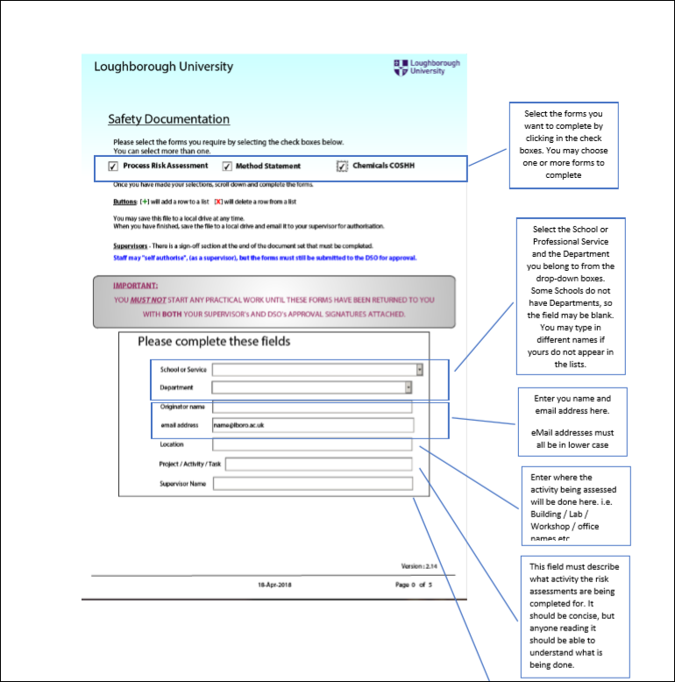
Safety Risk Assessment Example
The link(s) below are a useful guides for how to complete them.
https://learn.lboro.ac.uk/pluginfile.php/1095403/mod_resource/content/2/New%20Safety%20Documentation%202018%20Training.pdf
Material Data Sheet guidance can be found at:
https://learn.lboro.ac.uk/pluginfile.php/1095404/mod_resource/content/3/Material%20Safety%20Data%20Sheets%20Explained.pdf

Slide 15
Types of Risk Assessment
4)Lone Working out of hours Risk Assessment
Use the general process risk assessment template
Consider:
Have myself and supervisor signed it?
Have I clearly stated what I will be doing indicating times?
Have I considered all the additional risks of working alone?
Have I got an emergency contact?. Do they know?
Have I added the location where I will be working?
Have I got the lone working app?

Slide 16
Writing Risk Assessments
Look at examples of existing Risk Assessments for quality required
Do not blindly copy and paste large sections without evaluating if this applies or is relevant to your work.
Do a first attempt and then seek help and support from your supervisor, members of your group or CBE Experimental Officers and Technician in sections you are unsure of.

Slide 17
Risk Assessments for Processes/Experiments
Check the Process Risk Assessment spreadsheet
Does an existing Process Risk Assessment already exist similar to your proposed work?
If it does - write a Risk Assessment Review Record to detail your intended work.
If the process is similar but the chemicals involved/other aspect have MINOR differences write a Risk Assessment Review Record to document the changes and list all additional hazards/control measures.
If a Process Risk Assessment does not exist for your proposed work or an existing Risk Assessment requires MAJOR changes – write a new one and include the process and all chemicals associated with the process.

Slide 18
Risk Assessments for Chemicals
Check the Chemical Inventory spreadsheet and list of associated process risk assessments
Does an existing Process Risk Assessment exist that includes your proposed chemical or is there an existing COSHH ?
If YES and its similar to your proposed work - write a Risk Assessment Review Record to detail your intended work.
If the process is similar and there are only MINOR differences in the chemicals uses write Risk Assessment Review Record to document the changes and list all additional hazards/control measures.
If a Process Risk Assessment or COSHH does not exist for the chemical you propose or there are MAJOR differences ( more hazardous) from an existing process risk assessment – write a new one and include the process and all chemicals associated with the process.
Form will guide you to complete a DSEAR assessment if one is required.

Slide 19
Risk Assessments for Biological Material
Check the Biological Risk Assessment spreadsheet.
Does an existing Biological Risk Assessment exist that includes your proposed material ?
If it does and its similar to your proposed work - write a Risk Assessment Review Record to detail your intended work.
If the process is similar but the biological material involved is only MINORLY different write Risk Assessment Review Record to document the changes and list all additional hazards/control measures. Vice Versa – if the process is MINORLY different but the Biological Material is the same write a Risk Assessment Review.
If a Biological Risk Assessment does not exist for the material you propose or the process/material are MAJORLY different ( more hazardous) from an existing Biological risk assessment – write a new one.

Slide 20
Existing Risk Assessment Review Process
Risk Assessments should be reviewed annually or before if a change occurs.
Reviews can be for MINOR or MAJOR changes but both need to be assessed and recorded.
Risk Assessment Review Record should be used. Detail in here what the change is and why.

Slide 21
Risk Assessment Review Record ( found on CBE LEARN page)

Slide 22
Risk Assessment Reviews :Minor
Minor Changes are - new person added, updated model of equipment, new location ( if it is in same facility and does not effect risk), new supplier of material .
Minor change - detail exactly what the change is and state the things that will remain the same including the risks ( if risk does change a new risk assessment should be done)
If it is to add someone new to the risk assessment - detail exactly what the person will/wont be doing as part of that risk assessment. State the training/supervision they have/will have.
If it is an annual review of a risk assessment and no changes have occurred this should be recorded in the risk assessment review form.

Slide 23
Risk Assessment Review: Major
New Risk Assessment required or major re-write of existing Risk Assessment but Risk Assessment must be re-submitted and approved.
Please see next slide for list ( not exhaustive) of possible reasons for major review.

Slide 24
What is considered a significant/Major change that requires a new risk assessment instead of a review?
1)Change to the risk of initial risk assessment
2)Change of process/equipment/procedures
3)Change/addition of material used if effects the risk ( i.e addition of unscreened material)
4) Change in the scale of operations
5)Change of location if it effects the risk ( new facility)
6) Change in the containment conditions or control measures
7)Change in the waste treatment procedures
8)Changes to people responsible
9) Changes to the properties ( more virulence, mobility, differences in growth/media, etc)
E.g With a new strain of bacteria , if the hazard group is the same as the previous strain and the new strain has similar properties to the existing one, then that is fine. If the hazard group changes or the new strain properties are different (potentially increasing the risk) then a new risk assessment would be needed.

Slide 25
Things to consider when writing a New CBE Risk Assessment
Have I answered all questions( parts of questions) fully?
Has my supervisor reviewed and signed it?
Have I included any supporting information? ( e.g SDS for a chemical)
Does the title tell the reviewer what the risk assessment is about?
Have I considered and documented the disposal route in full? Do not use one of the pre-selected answers. Overtype the full details.’ I will ask the technician’ is not acceptable.
Have I referenced any SOPS correctly? Are they for the equipment I actually use? Am I trained to use it?
Can a safer alternative be used?
Is the storage facility I have stated actually available?
Have I considered if the chemical ( for a COSHH) is compatible with virkon?
Do I know what symptoms to be aware of when using a certain chemical?
Am I aware of how to proceed if an accident occurs, e.g. user inhalation or chemicals comes in contact to naked skin. There are chemicals that should not come into contact with water and there are specific antidotes that need to be in the lab.

Slide 26
Things to consider when writing a New CBE Risk Assessment cont…
Have I considered the impact of mixing two chemicals?
Have I thought carefully about the spill response? What is the best thing to use? Do we have it? Have I discussed procedures for the size of the spill?
Have I written down the steps in detail of what I am going to do?
If I have answered YES to a section or highlighted a risk have I given enough detail of mitigation?
COSHH for kits – risk access/list all hazardous components but ensure you list the non-hazardous ones in the comments section ( as these will be mixed with hazardous components).
If you are mixing two chemicals ensure you risk assess the end product as this is what people will be using.
Do we actually have the PPE I have listed? Is the PPE adequate for protection required e.g type of gloves?
Hazards will not always be linear – be careful when scaling up
Don’t put a control measure down if we don’t have it
Have I included the location where I will be doing the experiment?. Is it appropriate for the material/work I am doing? (e.g volatile chemicals must not be used in a BSC).

Slide 27
Things to consider when writing an Out of Hours Risk Assessment
I)Have I named an emergency contact and does that person know they are the emergency contact?. Does this person have enough CBE laboratory knowledge to do this role?
ii)Have I detailed exactly what I need to do out of hours including equipment used, location, approximate times, length of work?
iii)Have I mitigated any risks highlighted?
iv)Have myself and supervisor signed it?

Slide 28
CBE Risk Assessment Approval Process
New Risk Assessment written/ Risk Assessment review form written
Risk Assessments must be meticulously checked and signed by supervisor. The Supervisor is the first reviewer and must return risk assessment to proposer if amendments are required or information is missing.
Reviewed Risk Assessments signed by the supervisor must be sent for approval to
Shared.ws.safety@lboro.ac.uk
Risk Assessment approved by member of shared safety team or author is contacted to make amendments.
Approved signed copy is sent to author. A copy must be sent to Laboratory Manager
Laboratory manage acts as Document Controller and files risk assessment centrally.

Slide 29
Where are Risk Assessments stored?
CBE LEARN page
CBE WorkSpace ( CBE-QUAL)/TEAMS
Hard copy file

Slide 30
More Information can be found…
CBE LEARN page
CBE SOP048 Production and Control of Risk Assessments.
Attending University Risk Assessment Training Courses
Reading University Risk Assessment polices and guidance notes.
https://www.lboro.ac.uk/media/wwwlboroacuk/content/healthandsafety/downloads/Completing%20Risk%20Assessments%20–%20Health%20and%20Safety%20Guidance.pdf

