Slide 1

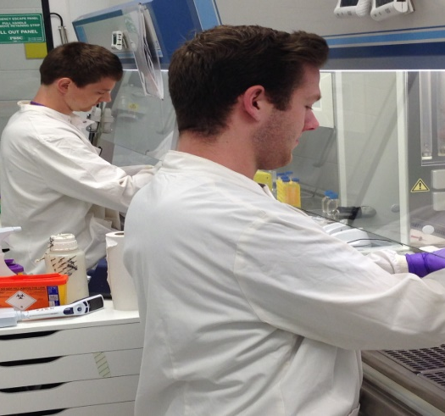
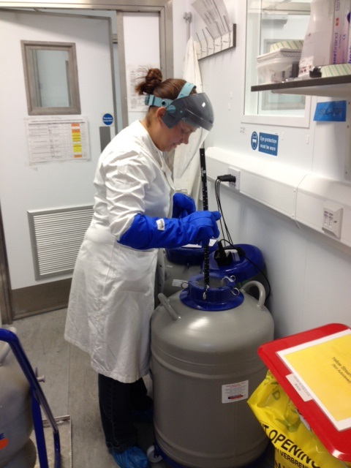
Centre for Biological Engineering (CBE) – Safety Induction Training

Slide 2
What will this training cover?
This presentation will cover:
CBE facility
The Code of Practice, Quality System, Training & SOPs.
Local rules & procedures
Risk Assessments
Access Restrictions
Procedures for working in the CBE
Responsibilities of all Lab users
Routes of infection.
Controlling exposure: PPE, BSC.
Experimental work.
Disposal of Biological & chemical Waste & autoclaves.
Safe Use of Liquid Nitrogen.
Emergency Response : Biological & Chemical Spills, Accidents & incidents, Fire & First Aid.

Slide 3
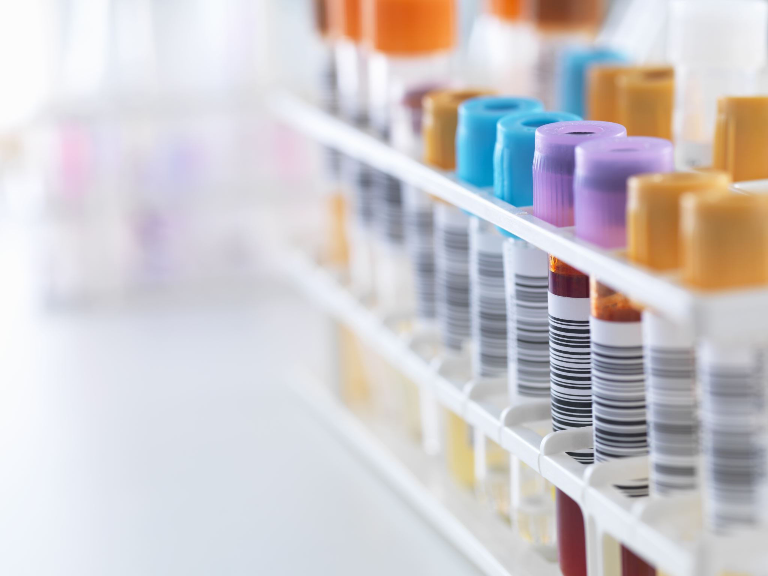
Introduction
The CBE facility is a self-contained, Containment Level 2 Laboratory Unit.
Certain rules & procedures apply when working in Containment Level 2 laboratories such as restricted access, specified disinfection procedures, use of Biological Safety Cabinets, sealed centrifuges & autoclaves for sterilisation of waste materials.
The CBE Laboratory Unit is a shared multi-user facility & the space is also shared with a private external company.
Much of the work in the Unit involves biological material. The Unit has therefore been designed as a controlled environment and operates under a Quality Management System
CODE OF PRACTICE – Legislation /Single point of reference for biosafety
CBE Quality System - A quality system describes the strategy to minimise the potential for contamination and/or infection in order to maintain the integrity, validity and reproducibility of any work conducted in the CBE laboratories.

Slide 4
Biosafety
Biological Safety Policy | Health and Safety Service | Loughborough University
Code of Practice for Bio Labs | Health and Safety Service | Loughborough University
Click the links to find out more…

Slide 5

Risk Assessment
A risk assessment is a legal requirement
Identifying potential hazards & risks of the proposed work & ensuring adequate controls are in place to keep people safe.

Slide 6

Five types of Risk Assessment…
1) Process Risk Assessment - needs to be completed for a
new procedure/project or piece of Equipment
2)Biological Risk Assessment ( BRA) – Biological material
3)Chemical ( COSHH) – New hazardous material.
4)Genetically Modified Organisms Assessment (GMO)
( Only required if cell line is modified, accompanies BRA).
5)Lone Working ( this needs to be done on the process Risk Assessment form)
1,3,5 Send to shared safety E-mail ( shared.ws.safety@lboro.ac.uk ). Attach SDS for COSHH.
Biological/GMO should be sent to & reviewed by Laboratory Managers first. Ensure all sections are complete and has been signed by your supervisor. HG1 can be approved by Laboratory Manager. HG2 needs to be approved by the Biosafety Supervisor.
See Separate Risk Assessment Training for more details.
See H & S webpage for templates.
Notes:
NOTE: BRA – Hazard group 1 can be approved by designated people in the CBE. Hazard group 2 and GMO must be sent to safety office for approval.

Slide 7
Risk Assessments
Review regularly, complete revision form for minor change ( E.g someone else working on project). Re-approval required for major changes.
Must be completed before acquiring material & must be completed & approved before commencing work.
Ensure Laboratory Manager is aware of submitted Risk Assessments & receives signed approved copy.

Slide 8
Human Tissue Authority (HTA)
Human Tissue Authority
Human Tissue Authority
The Human Tissue Authority (HTA) was established by the Human Tissue Act 2004 to regulate the removal, storage and use of human tissue
( “Relevant Material”) for a range of activities, including ‘research in connection with disorders, or the functioning, of the human body’ . The HTA regulates and inspects organisations involved in these activities.
The HTA defines relevant material as ‘material, other than gametes, which consists of or includes human cells’
The University holds a Human Tissue Authority (HTA) license for Research
Loughborough University HTA License Compliance Quality Manual has been produced for areas where this applies.
CBE came under license in September 2016. This requires us to comply to certain regulations in addition to the safety regulations we already follow.
Everyone needs to be aware of HTA but you only need to follow HTA Regulations if you intend to work with HTA Relevant material.

Slide 9
Human Tissue Authority
What do I need to do?
If your work is classed as HTA Relevant you need to have …..
Separate HTA training – Speak to lab managers
Material Transfer Agreements (MTA)/Service Level Agreement
Tracking, recording of samples from arrival to disposal
Completion of Authorisation & Acquisition forms
Storage Segregation of HTA material in designated areas
Keeping documentation/consignment records
Do not touch/move HTA relevant material that is not your own.

Slide 10
Ethics
Ethics - What are they & why do we need them?
•Ethics are the moral principles that govern a person's behaviour, or how an activity is conducted. Ethics in research determine the standards that you work to and your code of conduct whilst carrying out your research work.
–Legal responsibility to ensure that ethical review has been carried out.
•Adherence to any research licences.
•Evidence adherence to Health and Safety Law and any associated legislation.
•Doing things to people without their consent (even if it is in the name of science) could be classed as an assault under common law.
•Insurance.
•Research institutions will not allow research on human participants to take place unless it has undergone ethical review.
–Publishing houses will not publish work with human participants that has not undergone ethical review.

Slide 11

Ethics, HTA & MTA
Ethics: ALL projects should have an ethics checklist or quick test completed as a minimum but you may need to complete a full application depending on the nature of your work (e.g. working with a cell line or blood that has been commercially sourced is likely to be a checklist as not working with human participants but you still need to complete this check). Do also remember to do a new checklist or update if your project changes over the course of e.g. your PhD. The checklist and info about the application can be found here: https://www.lboro.ac.uk/internal/research-ethics-integrity/research-ethics/project-need-ethical-review/. The pink box on the right hand side will also take you to an FAQ style section “ethical review” on what to do if working with e.g. military applications or animal tissues.
HTA: remember to speak to your Departmental Quality Manager, Carolyn/Kul, or persons designate, Rob if you have any questions about whether the material you are working with is or isn’t HTA relevant. If you are working with HTA relevant material you should already have completed your University HTA training & local training from Carolyn but if you need a refresher on e.g. Procuro, please don’t hesitate to reach out. Compliance with our licence is incredibly important and we need everyone to do their bit – so logging material into and out of Procuro, completing paperwork and so forth.
MTAs: If you are bringing ANY material into or out of the CBE from another Institution (UK or globally) or industrial partner, whether it is a biologic, chemical, HTA or non HTA, an MTA must be in place. See here for details of the forms (https://www.lboro.ac.uk/research/support/collaboration/) but in brief, you will need to complete a checklist first which provides either KAREn (HTA) or Julie Turner (non HTA bio +chemicals) information about what you are bringing in/out, why, where to, paperwork in place (e.g. ethics, consent) etc. Once we sign this off you can then ask for the legal part, the MTA itself to be drawn up (this will cover ownership, IP, etc).

Slide 12
Ethics –Scenarios
I am buying a cell line from ATCC directly: complete ethics, a biological risk assessments and SOP008.1 Management & control of Incoming Biological Material form with certificate of analysis attached when it arrives.
I am buying a HTA relevant material commercially (e.g. blood, PBMCs): complete ethics done, biological risk assessments and CBE AAT Authorisation to Acquire or Transfer HTA Material HTA form. Once the material arrives, log in Procuro and ensure it has a unique identifier ,complete the CBE ARF Acquisition & Receipt of HTA Material Form and attach a copy of the accompanying paperwork/shipping information. Ensure your HTA training is up to date and evidenced in your training file.
I am working with the University of Nottingham and they want to send me a genetically modified cell line they created: complete ethics, a bio and GMO risk assessment and MTA (checklist to Julie Turner) and complete paperwork as per SOP008.1 Management & control of Incoming Biological Material form with any certificate of analysis attached.
I am planning to work with animal tissues (whole organs or biopsies): notify Julie Turner as soon as possible - we may not have the appropriate licence in place (the animal by-product licence is very nuanced!) and application can take some time so the sooner you inform her, the better as work cannot start until this is in place. Alongside, you will need to complete your ethics, biological risk assessment and so forth as with other materials entering the CBE.
I am already working with human material that was commercially sourced but did not complete an ethics checklist: you cannot apply for ethical approval retrospectively but will need to complete your ethical review asap using links on previous page.

Slide 13

Safe Systems of Work /Standard Operating Procedures
Standard Operating Procedures (SOPs) are written documents/instructions detailing all steps and activities of a process or procedure.
Standard operating instructions for equipment on how to use it safely and maintain it correctly.
SOPs available on CBE LEARN page

Slide 14

CBE Local Procedures:
Purchase Orders
Safety Critical General consumables ( gloves, sharps bins,waste bags etc.) will be ordered by the CBE Support Staff Team. These will be placed in the store room/bulk store for all laboratory users to access. ( List A)
All other consumables ( flasks,tubes, filters) must be ordered by individual group budgets. These will be placed in the allocated space in the bulk store for each group. ( List B)
.

Slide 15
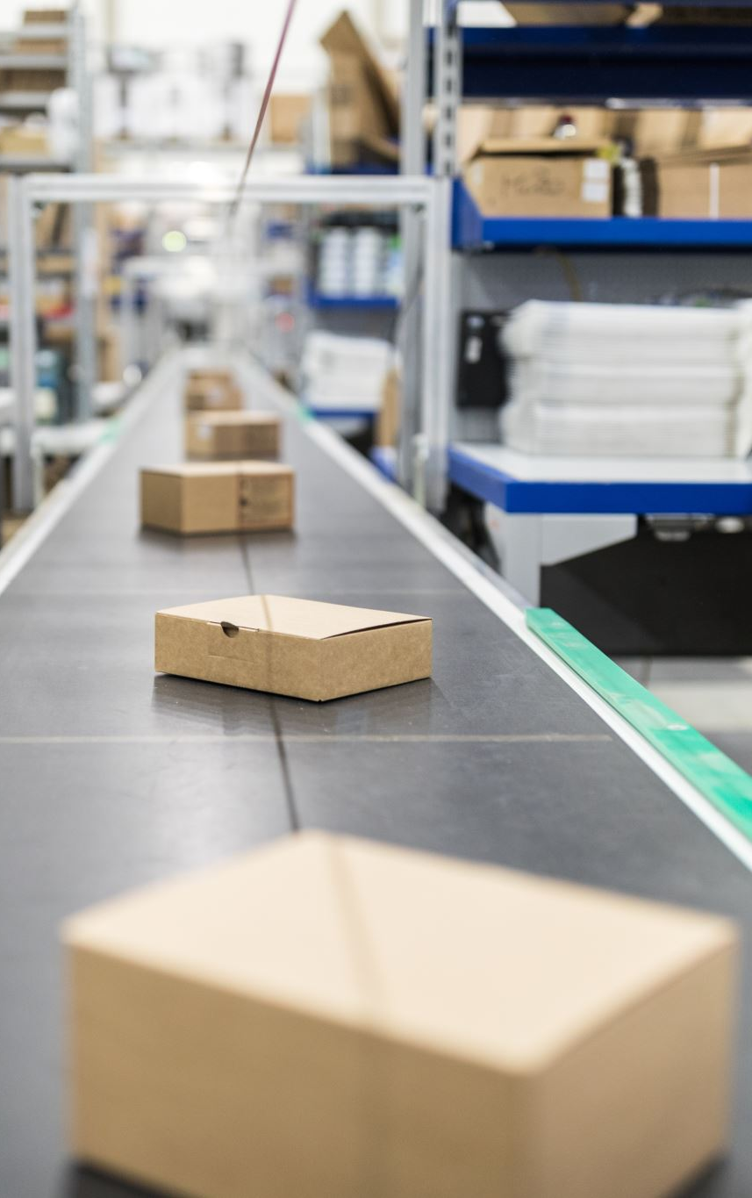
CBE Local Procedures:
Delivery of Goods
Goods are delivered to the individual Goods inwards areas in the two departments. Items must be brought across to the CBE.
All cardboard should be removed BEFORE entering the laboratory. This should be broken down & placed in trolley in office.
Goods should be taken through the first change & placed in their correct storage location within the lab. Excess stock should be stored in the bulk store room.
All hazardous Biological Material must be stored safely & securely in designated cabinets.
ALL dry ice needs to placed into the dry ice store in H34 or placed in Gas Pod 3 to evaporate . Please remember to retrieve the white polysterene boxes once it has evaporated & dispose of in general waste bin in courtyard.
Notes:
Thick Cardboard is not permitted in the CBE laboratories for two reasons. 1)It will have to be disposed of a CL2 waste which increases the waste we produce. 2)If cardboard gets wet it will provide moist environment for mould to grow. Remove items from cardboard box in the first change and then dispose of cardboard in the trolley in the office ( broken down). Most items come in secondary packing which keeps items sterile.

Slide 16

Access Restriction &
Opening Hours
Working hours in the CBE are 8am – 6pm Monday to Friday
If you require to work outside of these hours this is classed as ‘Out of Hours’ working. ( Office and Lab)
Subject to a lone working Risk Assessment approval an out of hours key will be issued to the laboratory. Please use the general process Risk Assessment form for lone working Risk Assessments.
Lone working Risk Assessment requires reviewing every three months or before if any changes occur.
You must :
Have an approved out of hours risk assessment written on the general process risk assessment form. Approved copy needs to be given to the lab manager.
You must notify security ( 01509 222141) when you arrive & when you leave.
You must designate an emergency contact & be aware of emergency responses.
Notes:
Please note out of hours working is for unavoidable infrequent work only ( e.g timed experiments, feeding cells). Working out of hours should not be the norm to your working pattern where you are performing work which could be done during normal working hours.

Slide 17
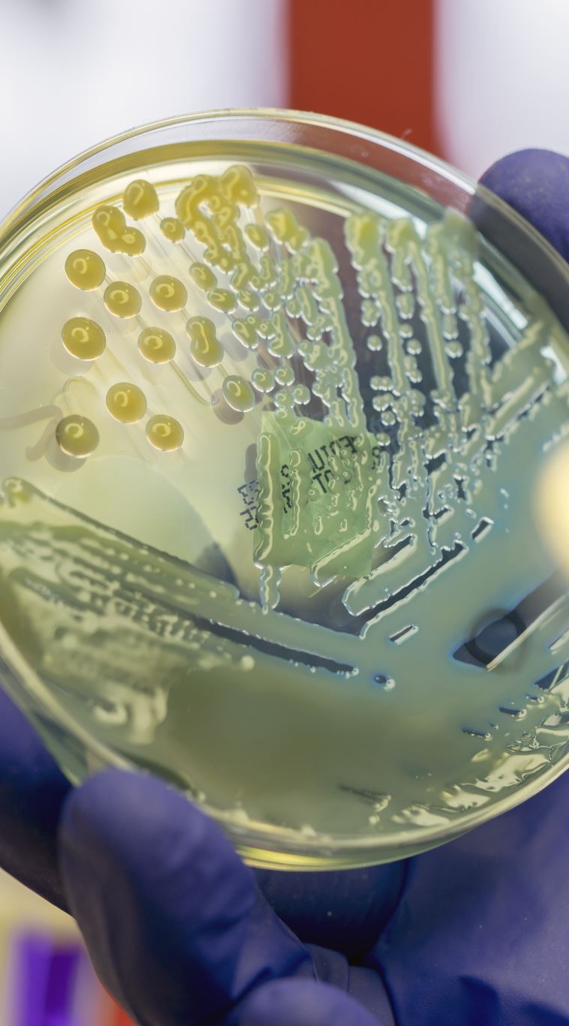
Access Restriction
Good Laboratory Practice CL2
No outdoor clothing, food, or drink are allowed in the laboratories.
All long hair should be tied back.
No open shoes ( No Flip Flops/sandals). ( Sturdy shoes should be worn for dispensing liquid nitrogen).
No Shorts/Skirts. Legs should be fully covered.
No lab coats to be worn in office areas.
Lab coats to be worn, properly fastened, at all times in laboratory areas.
On entry into the first change room (H32) put on a pair of gloves and spray with 1:50 ChemGene. It is good practice to change your gloves regularly.
Shoe covers should be donned in the first change.
Lab coats should be removed, gloves & shoe covers discarded & hands should be thoroughly washed with soap & warm water before leaving the laboratory.
It is good laboratory practice to leave your work area clean & tidy, return all reagents to fridges/storage areas, autoclave waste produced & clean down with 1:50 Chemgene and 70% IMS

Slide 18

Access Restriction
Keys, Access and authorisation
Access is for authorised personnel only when trained to do so.
Gas Pod/Back door/Chemical cabinet Keys – key cabinet first change. Return after use.
The key to the bulk store room is located in the main office.
People Flow – enter/exit through first change only except in event of fire

Slide 19
Access Restriction
Contractors, Maintenance Staff & visitors
The Laboratory Manager, or deputy, must be informed of any prior appointments . Any unexpected visitors must also report to the Laboratory Manager in case of any adverse events occurring that day.
A Permit to Work ( PTW) form, available from the LEARN page , must be organised BEFORE the maintenance worker arrives and must be completed in their presence following a debrief of laboratory rules from an authorised lab user ( If they require to enter the Laboratory area).
All contractors, maintenance staff or visitors who enter the CBE laboratories must wear lab coats, gloves, shoe covers ( & safety glasses in certain areas).

Slide 20

Control Exposure
Routes of infection
Ingestion
Inhalation -Do not create aerosols ( by vigorous shaking- use BSC).
Percutaneous - Cover damaged skin and minimise risk of puncture wounds
Instillation- Do not contaminate eyes by splashes or transfer ( use eye protection).

Slide 21

Controlling Exposure
PPE
Individual Risk Assessments highlight appropriate PPE for work undertaken.
Minimum PPE for CBE is Laboratory coat, gloves, enclosed shoes & shoe covers.
Safety glasses are mandatory in some areas of the CBE & for certain activities.
Other PPE includes face visors, cryogenic gloves & autoclave gloves.
Remove all PPE before leaving CBE.
PPE is there for your protection and should be worn as instructed.

Slide 22
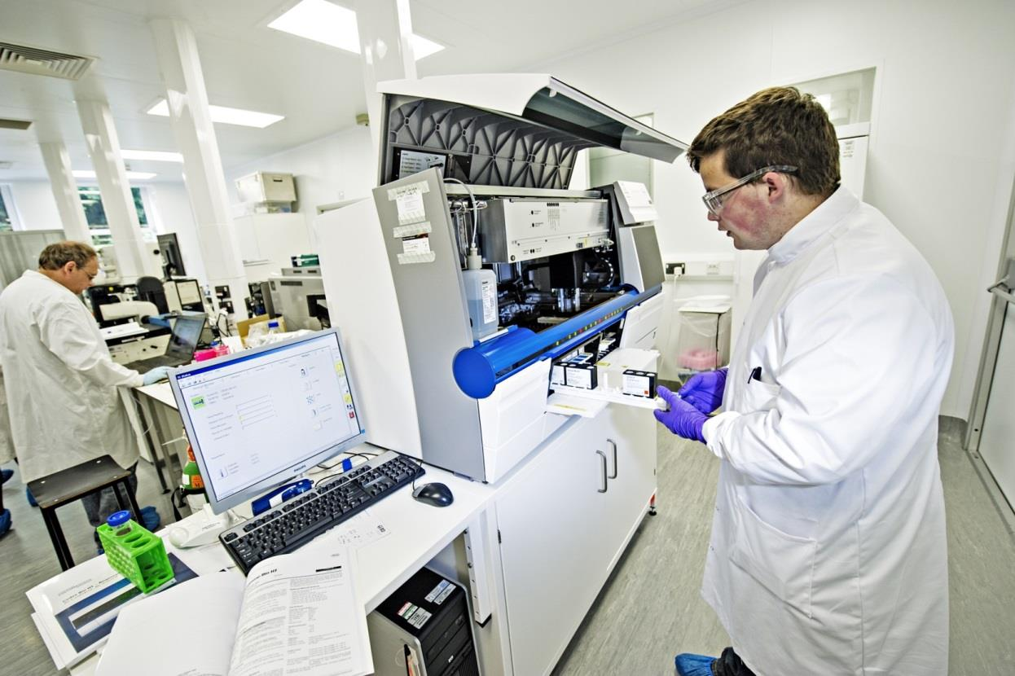
PPE
Notes:
PPE – Howie lab coat ( properly fastened to the neck ). Safety glasses, gloves, shoe covers.

Slide 23
Safety Glasses
It is mandatory to wear safety glasses/visor:
a) If it is stated in the Risk Assessment.
b) for the use of liquid Nitrogen.
c) for the use of autoclaves.
d) for the use of chemicals.
Everyone will have personal pair ( must stay in lab).
Spares & over spectacles available.
Visitors must follow same procedures.

Slide 24
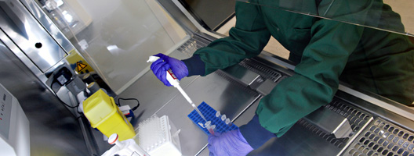
Controlling exposure: Biological Safety Cabinet( BSC)
Everyone needs to be familiar with how to operate them safely.
They protect you & the work.
Each individual worker must know how to:
Operate a BSC, including the use of UV, understanding the airflow ,how to decontaminate before & after use with 1:50 ChemGene & 70% IMS & what to do in an emergency.

Slide 25

Aseptic Technique Do’s
Notes:
Example of good aseptic technique

Slide 26
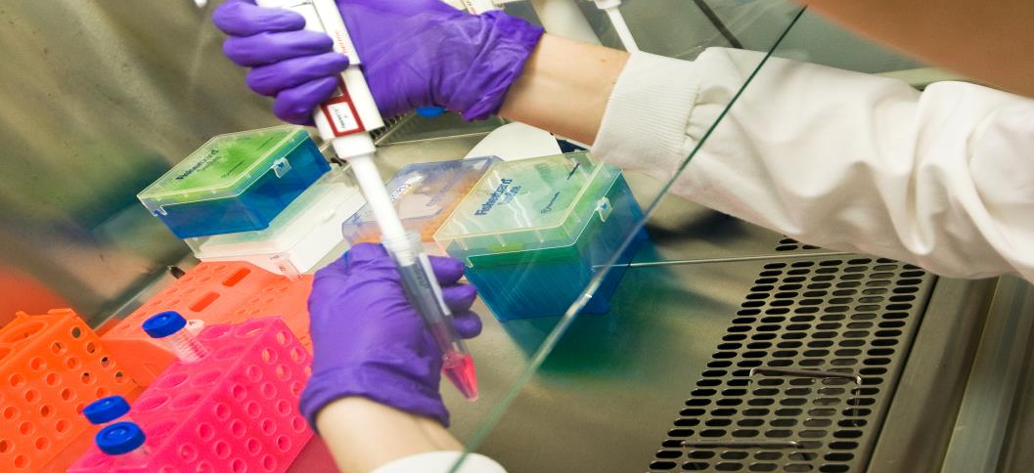
Aseptic Technique – Don’ts
Notes:
Example of bad aseptic technique. What three things are wrong and have the potential to cause a contamination?

Slide 27
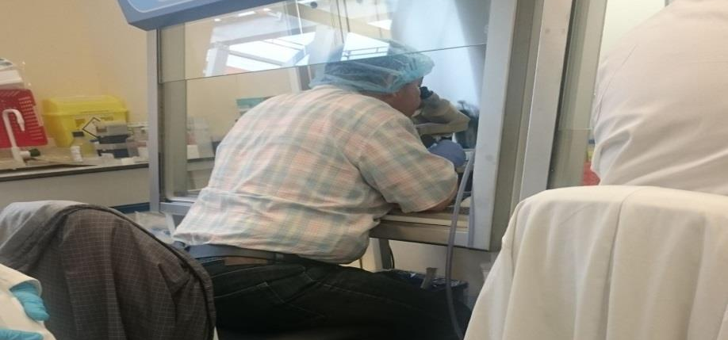
Correct Use of a BSC??
Notes:
Is this the correct way to sit at a Biological Safety Cabinet? What is wrong here?

Slide 28
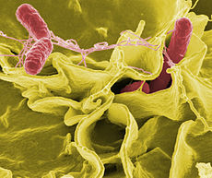
Dealing with cell culture Contamination
Identify it, deal with it, report it.
Discuss with lab manager/Technician
Complete contamination record Form
Follow instructions for how to deal with contamination and identify the cause.

Slide 29

Mycoplasma Contamination/Testing
Unique type of microrganism. Contamination with mycoplasma cannot be visualised by the naked eye or light microscopy. They do not produce turbid growth associated with biological or fungal contamination. Morphological cellular changes & growth rates of cell culture can be minimal or unapparent. Compromises results
Can mean lock down of a laboratory to contain it.
Important to purchase screened material or quarantine until checked.
We perform regular Testing for mycoplasma infections

Slide 30
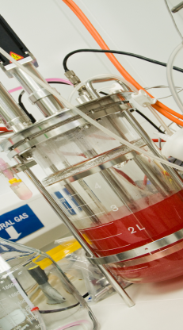
Experimental Work
Laboratory Books
It is recommended that all experimental work should be recorded in a laboratory notebook . Obtain from supervisor.
Equipment
Under Provision and Use of Work Equipment Regulations ( PUWER) each piece of work equipment must have a Risk Assessment, an SOP and users must receive adequate training to use it. This must be recorded. You must receive training to use equipment .
If you wish to use a piece of equipment you must read the relevant documentation , receive the training or ask someone to use it for you & enquire about receiving training.
Responsibility for key pieces of equipment will be divided between all lab users. This will involve ensuring all monthly maintenance & cleaning is performed on the piece of equipment & any problems reported & dealt with.
All Equipment Maintenance must be recorded on the Housekeeping sheets outside each laboratory.
Equipment Failure - If a piece of equipment fails while being used, report it immediately to the lab manager/responsible person..
Notes:
Please remember to complete equipment maintenance records ( found on the door to each lab)

Slide 31
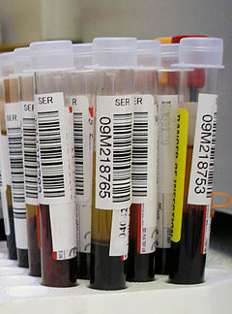
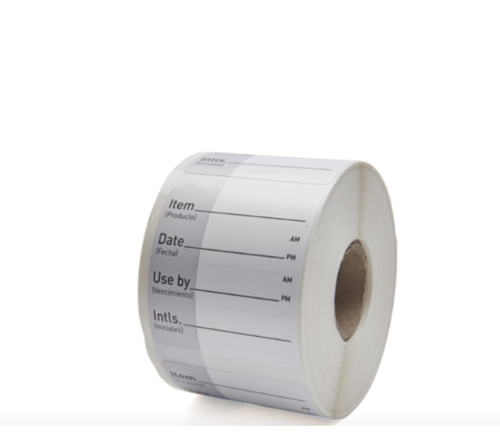
Working in the CBE…
Labelling
LABEL EVERYTHING!!!!!!!!
Labelling - : identity, preparation date, expiry date, hazard warnings, initials of worker & storage conditions.
Labels should be legible, old labels should be removed & labels should never be altered.
Unlabelled items should be disposed of ( Should be handled as though highly hazardous).
Once Opened, reagents should be labelled as such & disposed of appropriately when finished with.
Where possible thereshould be segregation of work.
Please use sticky labels provided.
HTA samples should be labelled with unique Pro-curo number.
Notes:
Please remember to dispose of opened items in fridges when you have finished with them.

Slide 32

Housekeeping
It is good Laboratory Practice to maintain a clean working area.
It is everyone’s responsibility to KEEP the LAB CLEAN, SAFE and TIDY.
Cell culture suites work on a ‘ Weekly Team Clean’ basis organised by those who work in those areas. Everyone MUST contribute.
Other areas are covered by team cleans on a rota basis. The rota is communicated to all lab users each week & the checklists of tasks outside respective laboratories.
It is the responsibility of the users to make sure all housekeeping duties are completed each week.
All authorised CBE users are responsible for disposing of the waste they produce.
In shared areas please do not leave housekeeping duties to the end of the week.

Slide 33
Incoming Biological Material
Procuring the Biological material
1)Complete Biological Risk Assessment
2)Select good supplier (Certificates of Analysis/testing performed)
Receipt & inspection of bio material
1)Check packaging/labels/delivery note/ C of A - PPE
2)Notify & store. If compromised return
Transfer to storage location
Any suspicious samples or samples with no provenance must be placed and used in quarantine.
Traceability of the material
1)Update Pro-Curo ( see next slides)
2)Complete Material Receipt checklist FSOP008.1( attach Certificate of Analysis ) submit to QM

Slide 34
Cryostorage/
Pro-Curo
CBE has 8 cryostorage Banks & one Experimental Bank.
Maintained by CBE technician
Use of Cryostorage Unit
When removing samples from, or placing samples in, the cryobank, remove the tower completely from the cryobank & place on metal tray on floor before removing the holding bar. This will remove the possibility of dropping boxes into the tank.
The cryoracks should not be kept out of the bank for more than 1 minute or there is a risk of damaging the viability of cells belonging to others. Please replace the holding bar!!
Pro-Curo –
This is software we use for recording / tracking the biological material we store in the cryostorage units. You will need to get this software installed on your computer and receive the training required. Each person is responsible for logging their own material.
Designated space in cryostorages ( allocated per group) )

Slide 35
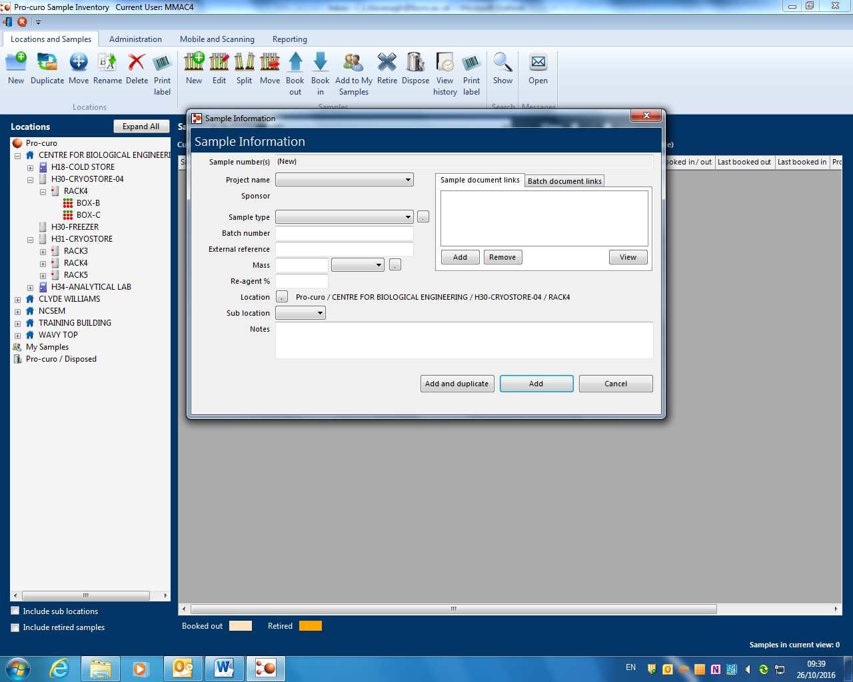
Pro-curo

Slide 36
Transport of Material
( External transfer)
All Biological & Chemical material should be transported to other laboratories outside of the CBE using secondary containment.It must be disinfected when leaving and entering new areas.
All Biological & chemical material MUST be exported to other laboratories using appropriate packaging, labelling & transport procedures.
Consider if a Material Transfer Agreements is required.
Please check guidelines or ask for advice.

Slide 37
Disinfection
1% virkon used for spills & aspiration bottles due to its broad spectrum properties.
NOTE: Virkon is not suitable for all pieces of equipment, if used on any metal surface must be removed after a maximum 10 minutes surface contact to avoid damage to the equipment.
1:50 ChemGene – spray onto paper towels
1:20 ChemGene – Weekly/monthly decontamination of equipment.
Ensure Chemgene is left to dry
70% IMS – Secondary ‘rinsing’ stage following Chemgene
Ultraviolet cleaner is used for cleaning the floor only.
SOP160 & Posters throughout the lab detail disinfectant to be used.

Slide 38
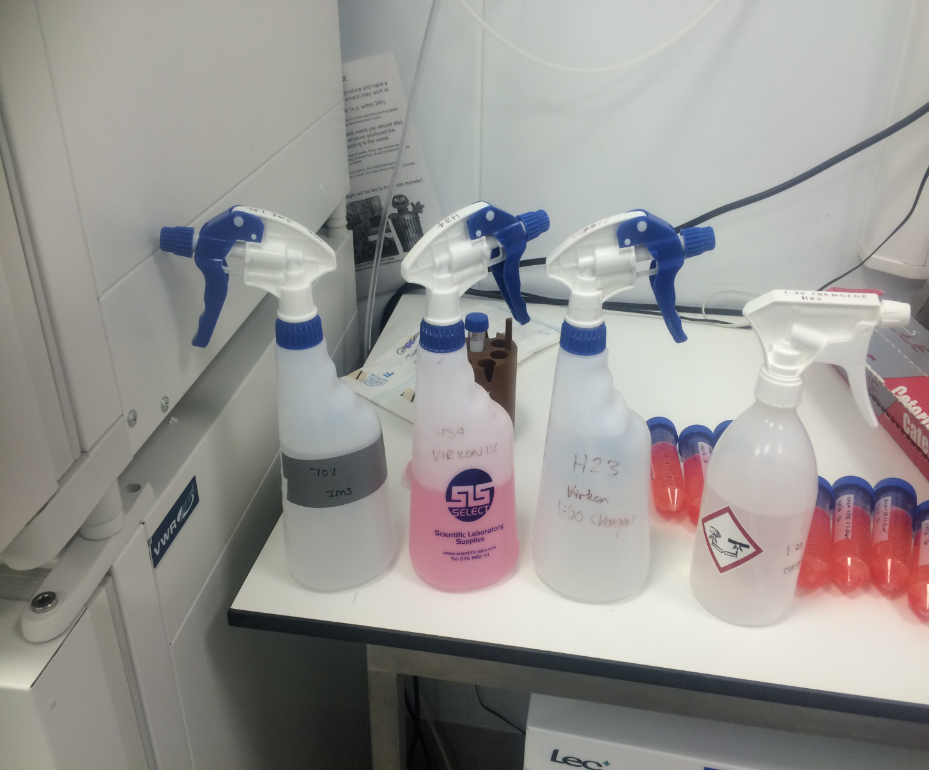
70% IMS
1% Virkon
1:50 Chemgene
1:20 ChemGene
Notes:
Different types of disinfectant. All bottles will be labelled.

Slide 39
Disposal of Biological Waste
University procedure is to always render waste safe before it leaves the lab.
The safe disposal of waste is an important aspect of safeguarding the H & S of employees.
Each worker in the CBE has a duty of care imposed under the environmental Protection Act to ensure that waste is managed properly and disposed of safely.
All waste that has been in direct contact with the living biological agent must be inactivated. Either by autoclaving or disinfection (virkon).

Slide 40

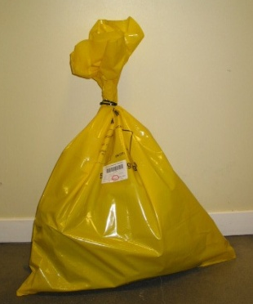

Types of waste
Three different types of solid waste:
  1) Cardboard & other paper waste that has not been in the Class II labs is left for domestic staff to collect in the office.
  Cardboard should NOT be taken into the CBE laboratories.
  2) Colour coded waste
  Yellow stream waste – Non- autoclaved waste
  ( chemically contaminated waste)
  Orange stream waste – Autoclaved waste
  Yellow & purple stream waste – Cytotoxic waste
  3) Sharps

Slide 41

Cytotoxic Waste
Cytotoxic solid waste must be placed in specific ( yellow/purple) bags & disposed of immediately after completion of work into designated holding area in Gas Pod 2.
DO NOT AUTOCLAVE.

Slide 42
Disposal Procedure – Sharps
Sharps – Yellow & orange
  Including needles, scalpel blades, pipette tips and small pieces of glass.
  Do NOT overfill or shake.
  When full, seal & carry using secondary containment to the autoclave. Place autoclave tape across the top to ensure sterilisation has been successful.
  Once autoclaved, place in designated secondary containment in the waste cage. When full this must be transported in designated lidded container to holding area in Gas Pod 2, ready to be incinerated.
  DO NOT place into biohazard bags.
  Glassware must be disposed of into designated broken glass containers.
  Put ALL disposable pipette tips in sharps container in BSC.
Notes:
Pipette tips should not be placed directly into autoclave bags to avoid sharps injuries. Please place in designated sharps containers.

Slide 43

Cytotoxic Sharps
All Cytotoxic contaminated sharps must be placed into designated purple cytotoxic sharps containers.
Incinerate ONLY.
When the containers are ¾ full, seal, wipe with virkon & transport, using secondary containment, to designated bin/container in Gas Pod 2/ courtyard labelled
‘ cytotoxic sharps containers only’.

Slide 44
Disposal of liquid waste
Residual liquid in flasks,tubes ( from cell culture while working in the BSC) should be aspirated into the waste bottle containing virkon ( attached to BSC).
Liquid waste can be decontaminated with Virkon for 24hrs before being discarded down the sink with plenty of water.
Large volumes of liquid waste can also be autoclaved ( must be validated).
Disposal of Cytotoxic Liquid Waste – Refer to COSHH & contact Departmental Safety Officer for Advice.

Slide 45
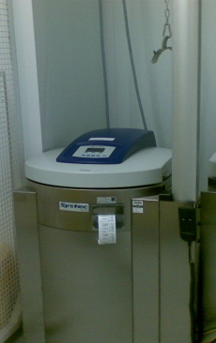
Autoclaves
Autoclaves can cause serious injury. Only authorised users are permitted to operate them.
We have two autoclaves in the CBE . Validated for solid & liquid waste.
Hazards:
Crushing/amputation.
Scalds – ALWAYS stand back when opening autoclave.
Wear a lab coat, autoclave gloves, impervious apron, safety glasses & closed shoes.
Hazardous materials must not be autoclaved (virkon/ChemGene/IMS soaked items)
Notes:
Autoclaves are pressure vessels. Ensure you follow procedures and use the PPE provided. When autoclaving liquid in a vessel NEVER screw the top on tightly.

Slide 46
Chemical Safety, Storage & Disposal of chemical waste
Safety
Always wear PPE
When pouring liquids this should be done very carefully to avoid splashing and the container opened away from you.
Adequate ventilation
Eye wash stations are located in all change rooms & in H34.
Refer to COSHH for First Aid & spill procedure.
Disposal
It is the responsibility of the worker to ensure safe and correct disposal.
All hazardous chemical waste should be decanted into labelled Winchester bottles
Please ensure you complete the label fully to describe the waste being disposed.
When the bottle is 3/4 full, it should then be transferred using secondary containment, to the holding area in Gas Pod 1
Storage
Chemicals are stored in designated chemical cabinets in H34 ( flammable, Corrosive & Poisons)
Store as directed on COSHH/SDS
Hazardous chemicals which require storage in spark free fridges/freezers should be well labelled .
There is fume hood available in H34

Slide 47
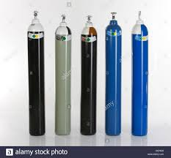
Gas Pods
Gas Pod 3 – i) Gases – Nitrogen
ii) Dewars for liquid nitrogen
Gas Pod 2 – i)Gases – 0xygen & Carbon Dioxide
ii) Biological waste collection point ( including segregated cytotoxic waste ( bags/sharps))
iii)Sharps collection point
Gas Pod 1 – i)Chemical Waste collection Point
ii)Empty Glass bottle collection point ( glass bottles should
rinsed out three times with water).

Slide 48
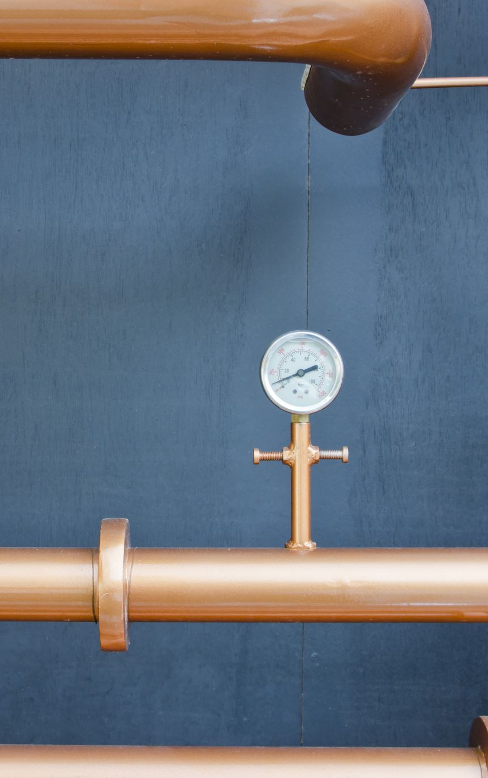
Gas Pods 2 & 3 - Gas Cylinders
C02, Nitrogen and Oxygen gas which is piped into the labs will be ordered through the consumable budget via lab manager/Eleri .
If you require these gases for your project ( excluding Co2) it is your responsibility to check stock levels in advance of requiring it.
Only trained personnel are permitted to change gas cylinders ( list on noticeboard).
The cylinders are set up in pairs with a changeover system.
The alarm panel for the gases is in the main CBE office. The alarm will activate when one of the pair of the cylinders is empty. When the alarm sounds this indicates that the empty cylinder requires changing by an authorised person to do this.
The cylinders are checked on a Friday to ensure there is an adequate supply to last over the weekend.
If the alarm sounds out of hours - DO NOT PANIC.
If you are not a trained authorised user to change a cylinder notify others by e-mail using Communications with all CBE lab users CBE-LAB-ONLY@jiscmail.ac.uk
This should not be an issue in most instances and be dealt with on the next working day ( provided there is still one full cylinder in place)
However, if the alarm is sounding during an extended holiday period ( Christmas/Easter) please contact the out of hours emergency contacts.

Slide 49
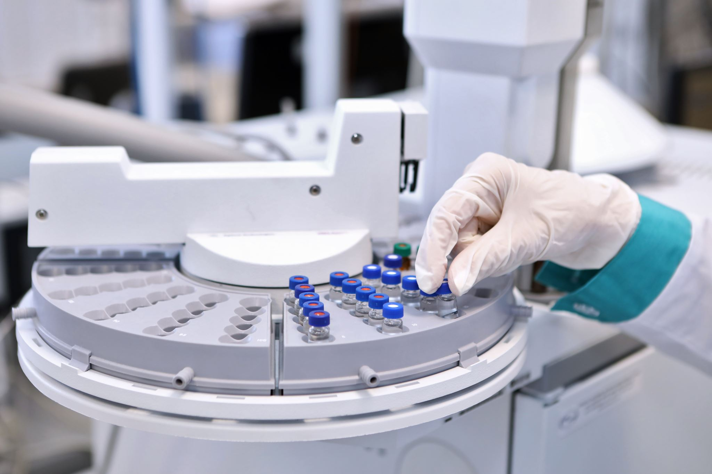
Safe Use of Liquid Nitrogen (CBE)
Long term storage of biological material
Hazards:
Asphyxiation – If liquid nitrogen vented in enclosed
space it can displace oxygen ( Oxygen monitors in place ).
Frost bite – Liquid & cold vapour can cause serious skin burns.
PPE required – Labcoat, Cryogenic gloves, protective footwear & face guard.
When decanting liquid nitrogen work in pairs with maximum ventilation.
Only authorised users are permitted to handle LN. Training required.
Training will be provided to demonstrate correct storage & handling of Liquid Nitrogen & highlight potential hazards.
Liquid Nitrogen is highly dangerous, it is very important that you feel confident to handle it & know what to do in an emergency.
Notes:
Remove purple gloves before you put on the cryogenic gloves to ensure that in the event of a spill into the gloves they can be removed quickly to avoid prolonged contact with the skin.

Slide 50
PPE for Liquid Nitrogen
Notes:
Demonstration of the PPE for cryostorage units. Face visor, blue cryogenic gloves. Here the level of liquid nitrogen in the cryostorage units is being checked. We do this twice a week to maintain adequate levels.

Slide 51
Oxygen Level Alarms
Low oxygen sensors are located in the CBE laboratories where LN2 is in use.
They provide continuous O2 monitoring. The sensors will alarm when there is a depletion of oxygen in the laboratory.
Control measures must be put in place to increase oxygen concentration i.e. increasing ventilation or decreasing the quantity of LN2 used in the laboratory.
If the low oxygen alarm is activated:
Laboratory should be evacuated.
Leave the laboratory door propped open.
Prevent anybody from entering until the alarm has stopped.
Contact the Laboratory Manager or Area Safety Advisor immediately.

Slide 52
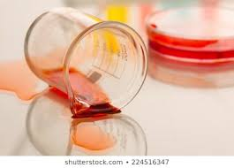
Emergency Response Procedures
Biological & Chemical Spills
Liquid Nitrogen Spills
Fire Alarms
Electrical Shutdown
Accidents & Incidents
Corrective & Preventative Procedures

Slide 53

Biological & chemical Spill Response
General laboratory rules
  Be prepared, spillages will happen, all workers must know the immediate procedures.
  Always have two people team, one to clean spill and another to cordon off area and warn other personnel.
  Clean up any glass using a forceps/sharps bin/lined labelled box.
  If virkon used ensure all waste goes into yellow waste stream bins and not into autoclave bags.

Slide 54
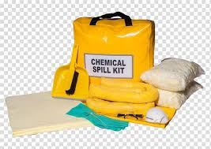
Biological & chemical Spill Response
Biological Spill Kits - change rooms and the autoclave room.
Chemical Spill kits - first change/H34 ( CBE)
Spill inside the BSC – Clear up immediately with paper towel soaked in 1% virkon, followed by ChemGene & 70% IMS. Decontaminate ALL BSC. See Spill Poster. Leave BSC on.
Spill in centrifuge – Turn off, leave aerosol to settle for 30 mins. Open buckets in BSC. Clean with 1% virkon followed by PH neutral detergent, 1:20 Chemgene and 70% IMS See Spill poster.
Spill outside the BSC:
Evacuate the area completely.
Remove contaminated PPE immediately & wash hands.
Place sign on the door to inform other staff of spillage.
Inform the laboratory manager or safety officer.
Detail the nature of the spillage, or detail size, colour & odour.
Access the risk.
Deal with the spill ( follow instructions in the spill kit & refer to SOP038 or individual Sop's depending on location of spill).
Fill in the spill record log in office area.

Slide 55
Spill Response
Liquid Nitrogen
As the CBE manually refills the cryostorage unit spills and accidental burns can easily occur.
Each worker must know what to do in an emergency.
External Spillages
Evacuated and suitably cordoned-off area.
Simply allow LN₂ to evaporate into the atmosphere.
Internal Spillages
Spillages of LN₂ to be not cleaned up!!! Allow to evaporate.
ALL personnel must be IMMEDIATELY EVACUATED from the surrounding area.
Consult Lab Manager and Departmental Safety Officer.
DO NOT enter/re-enter the laboratory until the oxygen levels have returned to safe levels .

Slide 56
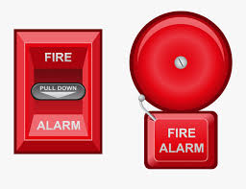
Fire Alarms
Fire Safety
  Fire Alarm tested every Tuesday at 9.15am. (CBE)
  Fire assembly Point is at the rear of the main building, adjacent to cycle shed . Assembly point 3. (CBE).
  Fire Marshals – Carolyn Kavanagh, Kulvindar Sikand, Jon Harriman and Jen Bowdrey (CBE)
  Fire extinguishers are located in the office & in the internal corridor in the CBE.
In the event of a fire alarm sounding, leave the lab immediately and go to the assigned assembly point.
Do not re-enter the building until authorised to do so.
If working in BSC do not switch it off.
If the fire alarm sounds while working with the Liquid Nitrogen, if it has not been possible to make safe before evacuating the building then the Fire Brigade need to be informed of the risk of Oxygen depletion.
Advise Fire Brigade of any potential hazards inside the laboratory.

Slide 57
Electrical Shutdown
Power
Power failure when working in the BSC - the device is no longer operative :
Cap
Immediately cap all culture vessels and media bottles that have been handled in the BSC. Leave all vessels in the BSC and discontinue the experiment.
Place
Place a “Do Not Use” label on the BSC.
Leave
When power supply returns, leave the BSC switched on for 30 minutes before commencing any work within the cabinet.

Slide 58
Air Handler Failure
The Air handler units in the CBE are used to maintain a positive pressure in the labs. This is something which prevents contaminants from entering the lab. The air changes also increase ventilation in the lab to mitigate against hazardous work.
Sometimes there is a fault with the air handling or it needs to be switched off for maintenance. This effects how we can operate safely in the lab.
How do we know the air handler is not working?
1)The doors to the lab will stay open/may alarm
2)There will be a whistling sound
3)Red Light(s) on the display panel in the office
4)Magnahelix gauges by the lab entrance will not show what they should.

Slide 59
Air handler Failure
Call FM 222121or Charnwood Reception 222200 if you think there is a problem
What precautions should be taken while Air Handling is off?
1)Work with hazardous chemicals should stop
2)Recirculatory BSC’s should be used for HG1 work.
3)Work in externally vented BSC’s should be avoided but if no recirculatory BSC’s are available extra precautions should be taken e.g checking flow rates.
Work with HG2 or GMO material should be postponed.
Discuss with Lab Manager/Safety Officer.

Slide 60
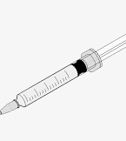
Accident and Incidents
Medical Intervention
COSHH Risk Assessment will indicate specific procedures but generally:
  Face/eye splash – flush eye with copious amounts of water for 15mins, in case of face being splashed wash with antiseptic soap and water, avoiding eye area.
  Sharps injury – wash area with antiseptic soap , do not force bleeding or suck wound. ALWAYS COVER WOUNDS before entering CBE.
  Ingestion – Contact first aider and seek medical advice immediately.
  Inhalation – Remove patient from immediate area preferably outdoors to fresh air. Contact first aider and seek medical advice immediately.

Slide 61
Accident and Incidents
Medical Intervention
Call first aider to the site of the incident
  CBE first aiders – Jen Bowdrey , Jon Harriman and Katie Glen
  First aider will administer treatment and decide if further medical attention is required.
  First Aid kit situated in the CBE office
Needle stick injuries are potentially very serious and should be reported & receive medical advice.
Occupational Health.
Any employee who believes they are suffering from ill health attributable to their work should report this to
Occupational Health | Loughborough University (lboro.ac.uk)

Slide 62

Accident and Incidents
Special cases….. Liquid Nitrogen
In the event of Suffocation:
  If person seems to lose consciousness while working with liquid nitrogen:
  Move to a well ventilated area immediately.
  Call for emergency medical assistance
  In event of Liquid Nitrogen Burns:
  Raise the temperature of the affected part SLOWLY back to normal. This is sufficient treatment in most cases where contact is not prolonged. However, prolonged contact may cause serious burns requiring more sophisticated medical treatment & you should seek medical attention immediately.

Slide 63
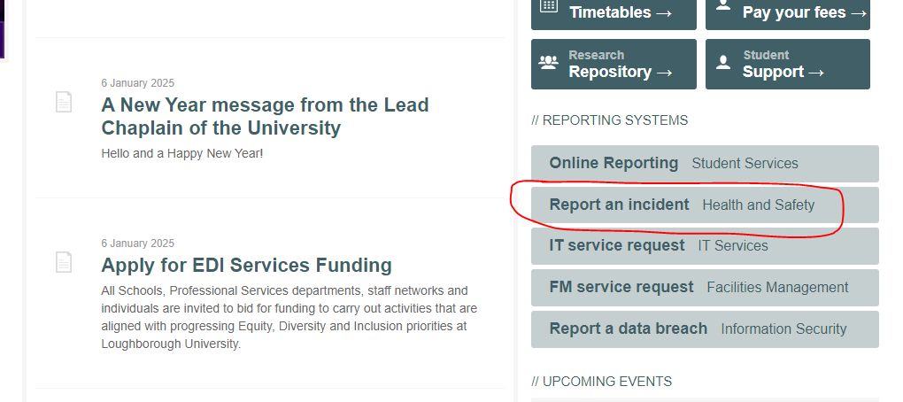
Accident Reporting
Accidents/Near Misses should be reported using the online system Evotix .
The link to access the form is on the University homepage.
. The system is to be used by both students and staff.

Slide 64
Accident and Incidents
Good Prevention Practices
Use plastic lab ware alternatives wherever possible.
Only use equipment you are trained and authorised to use.
Only use the correct tool for the job.
Keep work areas tidy (bench tops and floors).
Dispose of any chipped/broken glassware.
Good organisation, plan procedure to minimise transporting items/leaving work unattended.
If transporting , place into secondary container.
Avoid using sharps (needles) wherever possible.
If using needles never re-sheath, discard directly into a sharps bin.

Slide 65
Mental Health & Wellbeing
Your mental Health & Wellbeing is incredibly important
Please use the wide range of resources & support offered at the University.
Mental health and wellbeing | Student Services | Loughborough University (lboro.ac.uk)
Mental Health First Aid | Staff wellbeing | Loughborough University (lboro.ac.uk)
Staff wellbeing | Loughborough University (lboro.ac.uk)

Slide 66
Corrective & Preventative Action procedure
(CAPA)
A CAPA is required to be written if a non conformity or adverse event takes place. The author should be the person who encounters the problem.
Reasons for a CAPA might be a fire, accidental defrost of a freezer, lost samples etc.
Obtain a reference number from Quality Manager
Start the CAPA form ( form available on the CBE LEARN page )
Identify,track & investigate the problem
Submit to the quality manager
Cell culture contamination – complete cell culture investigation sheet and follow guidance.

Slide 67
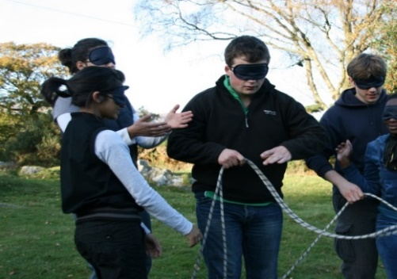
CBE Commitment Statement
What we expect:
Help with receiving deliveries and putting them away.
Answering the door/phone – pass on messages.
Communicate with each other if there is a problem.
Be collegiate
Be considerate
Share equipment – How long will you be leaving it unattended?
Comply with policies and procedures
Leave areas as you would expect to find them..
Attend and participate in Laboratory meetings
Participate in Laboratory Deep Cleans.
Attend Mandatory Training
Be part of the team, keep regular hours in the office.
Play an equal part in the weekly lab duties
Keep cell banking records up to date by updating Pro-curro
Ensure Risk assessments, BRAs and COSHH forms are all completed and the Laboratory Management have a copy.
Bring to the attention of Laboratory Management any concerns regarding health and safety in the laboratory areas.
Report any cell culture contaminations, spills, breakages and accidents

Slide 68
What we don’t accept…
Non-compliance to health, safety and quality procedures.
Lack of respect for the facility/equipment/other lab users.

Slide 69
Sustainability
LEAF Labs | Sustainability | Loughborough University (lboro.ac.uk) – Trying to look at ways for labs to be more sustainable ( reduce plasticware, switch off equipment etc)
WARPit | Sustainability | Loughborough University (lboro.ac.uk) – Repurposing of items/equipment
What you can do | Sustainability | Loughborough University (lboro.ac.uk)

Slide 70
Finally….
  Observe those parts of the University Health and Safety Policy that are relevant to your own work as well as observing any additional local rules and Regulations on health and safety published at CBE level.
  Read labels carefully.
  Wear PPE provided for your safety. Use safety glasses or face shields when working with hazardous materials and/or equipment.
  If leaving a lab unattended, ensure all bottles are capped and work area is tidy.
  ask if you are unsure.
  report any concerns.
  know emergency response procedures & what to do if you have an accident.
Be familiar with your Risk Assessments
Closely follow instructions provided for use of equipment, use it only for the purpose it was intended and never tamper with or over-ride any safety related devices.

Slide 71
You can find out more from….
The Code of Practice
SOPs
CBE LEARN page
Health, Safety & Environmental Department.
http://www.lboro.ac.uk/admin/hse/
Asking questions!!

