Slide 1
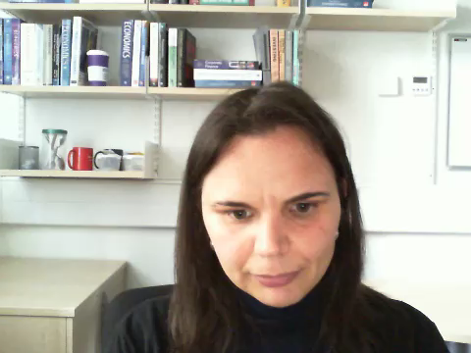
Introduction to Financial Economics
ECB004

Slide 2

About This Module
The aim of the module is to:
  introduce you to basic concepts in finance and equip you for further study in more advanced topics and modules in finance;
  explain the functions of capital markets in the economy, the ways in which economic activity is financed and implications for the flow of funds, and the role of the stock exchange in this process;
  explain basic techniques of financial analysis, especially the valuation of simple securities, including shares, bonds, and money market investments;
  examine investment decision rules;
  discuss issues pertaining to risk and the opportunity cost of capital;
  explain how corporations finance capital expenditure via equity or debt;
  examine a number of additional issues such as agency problems, market efficiency, payout policy, risk management, financial planning, and mergers.

Slide 3
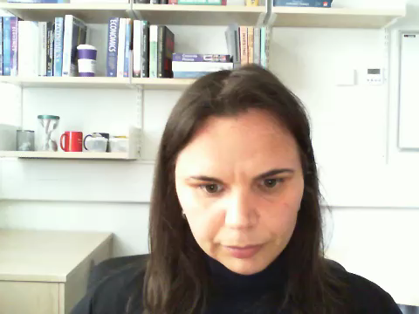
Wider skills and knowledge development
Students should demonstrate an understanding of basic financial concepts and data as they are reported in the 'Financial Times' or other journals of record; be able to critically evaluate and explain these reports to non-specialists; describe the main ways in which companies and other investors finance their activities and explain the role of the stock exchange in this process;
Students should have developed skills in the understanding, organisation, interpretation, critical analysis, and explanation of basic financial concepts and data, including applications used in everyday life.
Students should have developed skills in terms of analysis of argument and facts, numeracy, and problem-solving.

Slide 4

Teaching and Learning
Lectures (16 hours each semester) help students learn to discover important principles, concepts, and facts.
Tutorials (4 hours each semester) provide an opportunity for learning to be accomplished through a hands-on approach by solving problems.
Teaching staff
First semester
  Dr Valeria Unali (16 hours of lectures)
Second Semester
  Dr Allyson King (16 hours of lectures)

Slide 5
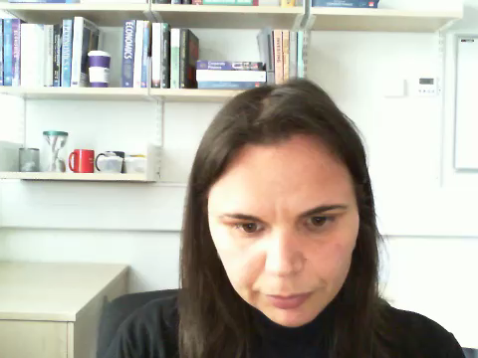
Assessment and Feedback
Methods of Assessment
A 1.5-hour exam at the end of each semester
Feedback is given to students in response to assessed work
  Generic written feedback on examinations will appear on LEARN following the publication of results. Individual feedback on exams will be given on request.
Developmental feedback generated through teaching activities
  Feedback on non-assessed problems solved during the course.

Slide 6
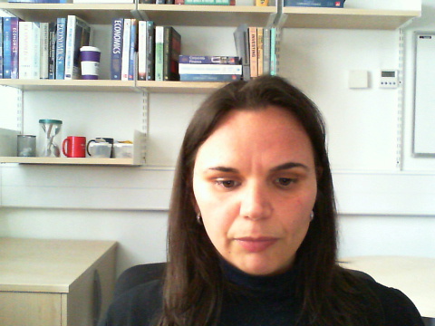
Why choose this module?
This module will introduce you to core concepts in finance which you will find useful in:
  studying more advanced topics and modules in finance;
  your future career in the financial industry
  making your own financial and investment decisions.
For further information contact:
  Dr Valeria Unali (v.unali@lboro.ac.uk)

