Slide 1


DECOLONIZING
ENTREPRENEURSHIP
IN POSTCONFLICT
SPACES
BSC059
Notes:
Image by Joe Webb
https://www.artcollectorz.com/artworks/artwork-detail?artwork_id=12641&edition_id=16151

Slide 2

evolution of business for changing global realities
Notes:
This is about making Business Studies relate to global realities
Black Lives Matter, global inequality, environmental destruction and many more social forces are all comments on how business is being conducted, and its negative, as well as positive, impact on all aspects of the world
Need to understand extent to which capitalism and business can reproduce or challenge these social phenomena
Image suggests at present, business is blindfolded to such change and is because of this going backwards (retrogressive)
It also indicates, by the presence of the hand, the social construction of business and therefore our capacity and responsibility to shape it fit for a changing world

Slide 3

WHY CHOOSE THIS MODULE?

Slide 4

most Business Studies content avoids bigger picture
Notes:
Focus on mechanics and technology rather than ideas and processes, a focus on detail at the expense of the bigger picture
Reluctant to engage with a wealth of understanding from sociology, anthropology, politics, international relations, international development

Slide 5

deeper discussion of what’s present in real-world business, but absent from Business Studies
Notes:
Most business studies courses allow only a partial accounting of business practice and theory, and ignore things like serious negative externalities like global heating, mass shootings, Greenwashing, Big Oil, Big Pharma, Big Money and so on
The module helps you fill in the gaps between what’s present in business, but absent from Business Studies
Allows you to take greater responsibility for your actions as business actors and make better, more informed choices about how you interact with business, with the planet, and with your futures

Slide 6
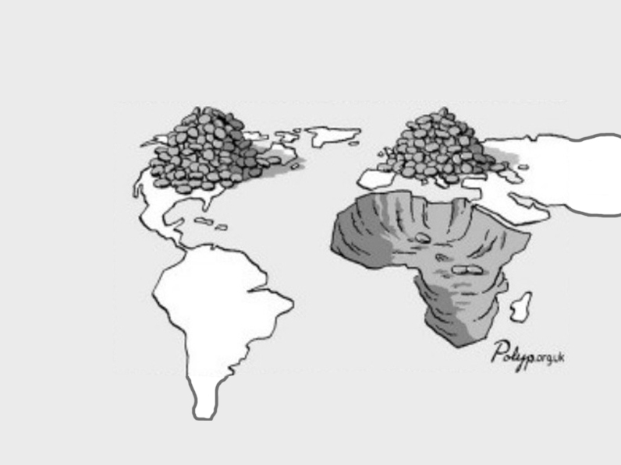
ignores role of global business in reproducing imperial-colonial relations, generally
Notes:
One of the major gaps refers to the ways BS rarely discusses the ways modern business acts as a legacy of empire
We may think of imperialism as over, but the asymmetrical terms and conditions it created have changed little, and continue to determine global business relations to this day
The module asks you to come to understand where power lies in international business rules, regulations, practices and beliefs.
Once you’ve understood this material and argument, you can then decide if you think this is reasonable or whether it needs change

Slide 7

examines how western business reproduces imperial power in former colonies
Notes:
The module is concerned with the ways that global business is not conducted on a level playing field. It addresses how that uneven playing field was constructed by the empires
Image represents figuratively a weighted world business system
The large blue sphere represents the continuing predominance of western business in the postconflict and postcolonial worlds
The smaller blue sphere represents the rules of international business, created under empire to exploit the southern hemisphere
These rules continue to determine who gets what, and on similarly unequal, uneven, unfair and repressive business terms that characterised imperial relations
It is a visualisation of an out-of-balance modern business world, originally and deliberately created that way under the empires.

Slide 8
AIMS
Notes:
You will develop more critical insight into Business Studies and capitalism as a whole
You will develop a more critical perspective on what entrepreneurship means in and for postconflict spaces
You will understand how business may reproduce imperial power relations
You will understand how the module is neoimperial in itself, because it is designed to give you power through knowledge to exploit postconflict spaces

Slide 9

value for real world employment
Notes:
You will be more conscious of the wider forces that enable or constrain your ambition, your corporate strategy, or an employer’s vision
You will be better able to navigate sensitive local environments that may have been impacted in earlier encounters with western business
You will understand how seemingly regular business interventions can reproduce imperial power relations that harm and disadvantage local people and communities

Slide 10

taught with multimedia pedagogy and course ebook
Notes:
I teach in multimedia because your brains are multimedia
Combine imagery and non-redundant text to reduce load on working memory and activate visual processing channel
This method is shown in published research to generate greater engagement, promote active learning and is also frequently better for people with dyslexia
http://www.vlebooks.com/vleweb/product/openreader?id=LBORO&isbn=9781527265059

Slide 11
WHAT IS EXPECTED OF YOU?

Slide 12

be present
Notes:
Bring your intellectual ‘A’ game
Keep your mind open to new ideas, and don’t be afraid of them
Don’t resist challenging concepts just because they challenge you
Be prepared to have to rethink much of what you think you know and believe
Listen without prejudice (thanks, George Michael ☺)

Slide 13

Assessment
1 x 2500 word essay, chosen from c.10 questions, marked online with written feedback

